Slide 1
Combining the Top-down Propagation and Bottom-up Enumeration for Inductive Program Synthesis
Woosuk Lee
2020. 10. 29 @ Seoul Nat’l Univ.
To appear at POPL’21
Hanyang University, Korea

Slide 2
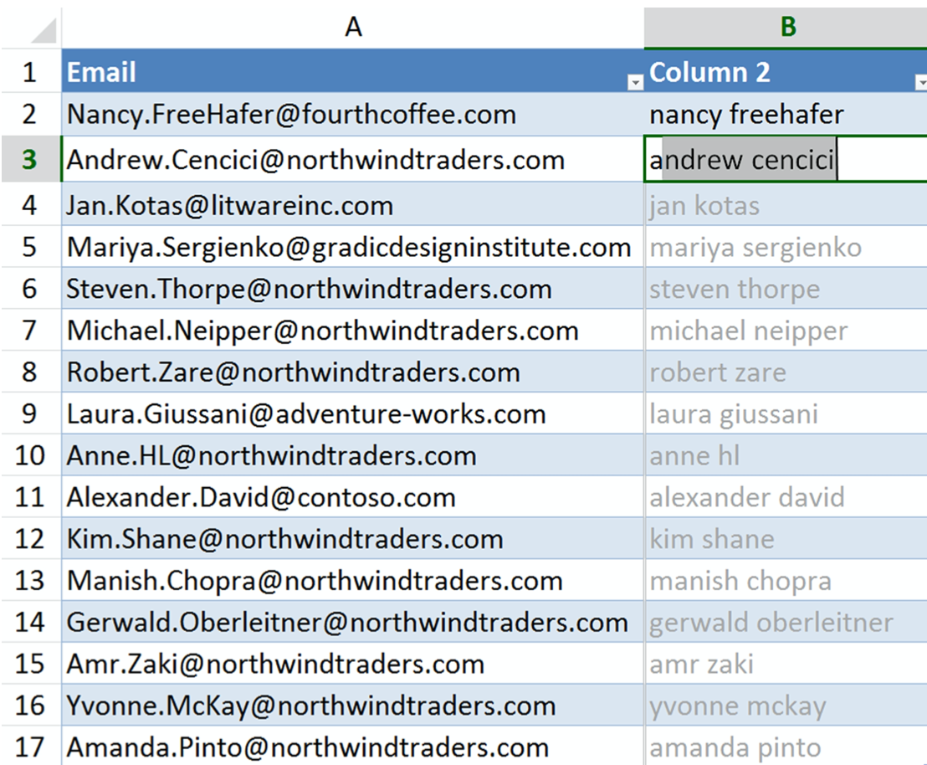
Inductive Program Synthesis
Generating a program in a domain-specific language (DSL) from input-output examples (a.k.a Programming-by-example (PBE))
End-user programming
Spreadsheet programming
[Gulwani et al. POPL’11]
Notes:
Inductive program synthesis, also known as pbe, aims at generating a program in a domain-specific language from input-output examples. Since input-output examples are readily available and appealing to end-users, this technology has gained increasing academic and industrial attention. The FlashFill feature of Microsoft Excel, which automates spreadsheet programming, is the most well-known example.

Slide 3
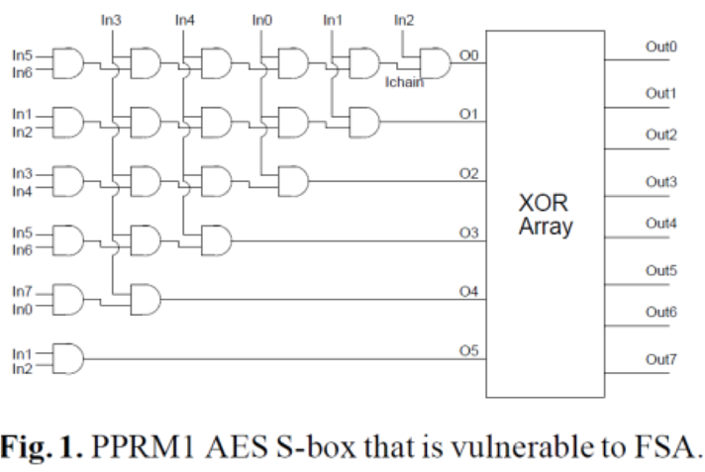
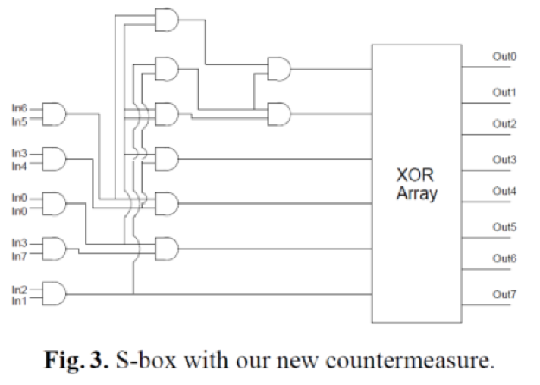
Inductive Program Synthesis
Generating a program in a domain-specific language (DSL) from input-output examples (a.k.a Programming-by-example (PBE))
Security &
Super-optimization
Optimizing homomorphic encryption applications
[Lee et al. PLDI’20]
Among many others
Program repair
Program deobfuscation
Program refactoring, …
Notes:
This technology has been applied to not only end-user programming but also a wide range of problems such as super optimization, program repair, among many others.

Slide 4
Dichotomy : “General-purpose” vs. “Domain-specific”
General-purpose synthesizer
Domain-specific synthesizer
Notes:
There is a dichotomy in inductive program synthesis: general-purpose synthesis
which works for arbitrary user-provided DSLs,
and domain-specific synthesis
that is only applicable for specific kinds of DSLs.

Slide 5
Dichotomy : “General-purpose” vs. “Domain-specific”
General-purpose synthesizer
Domain-specific synthesizer
Encouraged by a standard formulation: Syntax-guided Synthesis (SyGuS)
General search strategies (e.g., Bottom-up enumeration)
+ Broad application domains − unscalable
Notes:
General purpose synthesizers were encouraged by a standard formulation, syntax-guided synthesis (SyGuS) that has established various benchmarks through annual competitions. Using SyGuS, the user can freely describe a grammar that defines a target DSL along with semantic constraints on the desired program. Because a target DSL cannot be fixed in advance, they often adopt a general search strategy such as bottom-up enumeration which does not require any domain knowledge. However, as synthesis is a hard search problem, it is hard to scale without using domain knowledge.

Slide 6
Dichotomy : “General-purpose” vs. “Domain-specific”
General-purpose synthesizer
Domain-specific synthesizer
Domain-specific search strategies (e.g., Top-down propagation)
Successful industrialization (e.g., )
+ very efficient − only applicable for specific applications
Notes:
On the other hand, domain-specific synthesizers do not take a user-provided DSL definition but just take input-output constraints from the user. Over a fixed underlying DSL, a domain-specific strategy such as top-down propagation is often used. They are efficient enough for industrialization, so that commercial products such as Microsoft Excel, Powershell, and visual studio are equipped with domain-specific synthesizers. However, the major downside is limited applicability; only specific kinds of DSLs can be targeted.

Slide 7
Reconciling the Two Approaches
General-purpose synthesizer
Domain-specific synthesizer
Can we synergistically combine them to obtain the best of the two worlds (scalability and generality)?
Notes:
Our main question is this: can we synergistically combine the two approaches to obtain the best of the two worlds? In other words, can we obtain a general-purpose synthesizer to which the user can provide an arbitrary DSL while achieving performance comparable to domain-specific ones?

Slide 8
Our Contributions
A general approach to accelerate general-purpose inductive synthesis
Synergistic combination of a domain-specific strategy (Top-Down Propagation) and a general strategy (Bottom-Up Enumeration)
Application to the SyGuS specification language — efficient algorithm applicable for a broad class of inductive synthesis problems
Tool (Duet) and evaluation on widely applicable domains
significantly outperforms all the state-of-the-art synthesizers!
https://github.com/wslee/duet
Notes:
We summarize the main contributions of our work as follows: We propose a general approach to accelerate general-purpose inductive synthesis by synergistically combining two most well known general-purpose and domain-specific strategies. We have applied the approach to the SyGuS standard formulation, thereby targeting a broad class of synthesis tasks. Lastly, we implemented our approach on top of a tool called Duet which is publicly available.

Slide 9
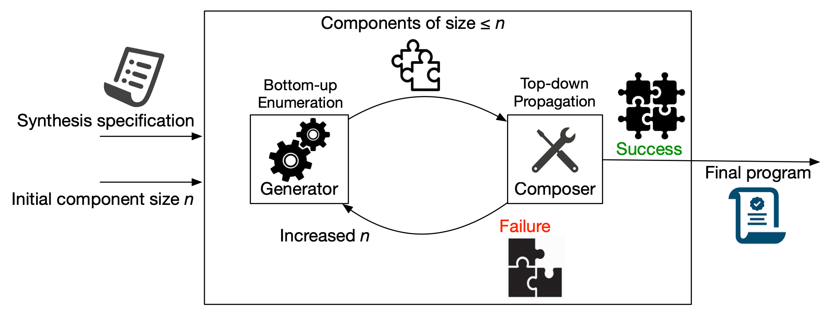
Our Duet
Domain-Unaware inductive synthesis via Enumeration and Top-down propagation
Notes:
Let me first describe the overall architecture of our algorithm which comprises two parts: generator and composer. The generator first takes a synthesis specification along with an integer n, and enumerates expressions which we call components whose size is smaller than or equal to n. These enumerated expressions are provided to the composer, which then tries to construct a solution from the components. The desired program may not be synthesized if the given set of components is insufficient. Then, we augment the component library by adding larger expressions and attempt to construct a solution again. This process is repeated until a solution is found. In the rest of the talk, I will first describe our approach and previous methods on an example synthesis problem formulated using SyGuS, and I will show you the evaluation results.

Slide 10
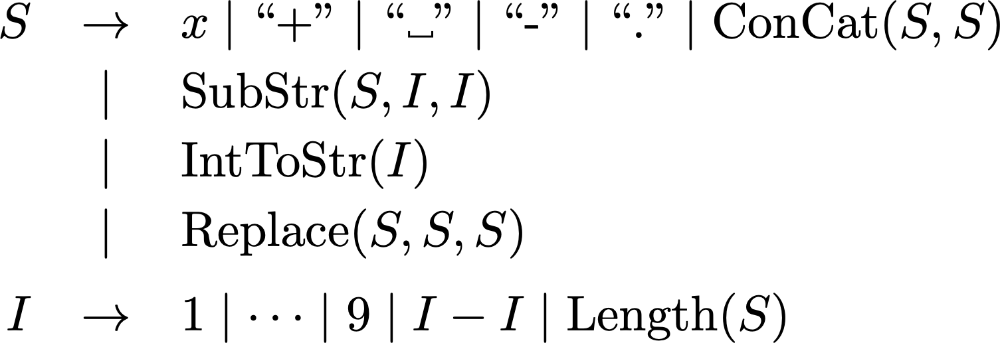
Example
Goal: function converting a given phone number into another format
Specification
Syntactic:
Semantic:
String concatenation
.
Notes:
Let’s suppose we want to synthesize a function f that takes a string of a phone number denoted x and outputs another string in a different format.
The syntactic specification is provided as this context-free grammar where S is the start nonterminal symbol. We consider programs that can contain constant strings plus, space, hyphen, and dot, and can perform string concatenation

Slide 11
Example
Goal: function converting a given phone number into another format
Specification
Syntactic:
Semantic:
e.g.,
.
Notes:
, substring extraction, int-to-string conversion,

Slide 12
Example
Goal: function converting a given phone number into another format
Specification
Syntactic:
Semantic:
e.g.,
.
Notes:
and string replacement operation that returns a new string where the first occurrence of the match string in the original string is replaced by the replacement string. The semantic specification follows the programming by example paradigm and comprises input-output examples given as this logical formula. We want to remove a leading space and a plus symbol, replacing a dot in the middle with a hyphen, and adding a dot at the end.

Slide 13
Example
Solution:
Size : 12 AST nodes
Notes:
The smallest solution to this problem is as follows. The size of the solution in AST nodes is 12.

Slide 14
Example
Solution:
 | Applicable? | Efficient?
Bottom-up Enumeration | O | X
Top-down Propagation | X | —
Our Method | O | O
Notes:
On this example problem, I will describe how existing strategies and our strategy work. Bottom-up enumeration, which is the general-purpose strategy, is applicable to this problem, but inefficient. Top-down propagation, which is the domain-specific strategy, is not even applicable. Our algorithm can efficiently solve this problem.

Slide 15
Existing Bottom-up Enumerative Strategy
Enumerate expressions in order of increasing size
Put smaller expressions together into larger ones
Size
Expressions
1
…
2
3
…
…
4
…
Notes:
The existing bottom-up enumerative strategy searches for the solution by enumerating programs generated by the given grammar in order of size. Small expressions are put together to construct larger expressions.

Slide 16
Existing Bottom-up Enumerative Strategy
Optimization: maintain only semantically unique expressions
Size
Expressions
1
…
2
3
…
…
4
…
+ Generally applicable − Limited scalability
Notes:
During the enumeration, they prune the search space using observational equivalence with respect to a given set of input-output examples. For example, two programs 2 - 1 and 1 generate the same output, only the smaller expression 1 is maintained and used for constructing larger candidates. While this simple strategy is generally applicable for almost all kinds of synthesis problems, it often does not scale.

Slide 17
Existing Bottom-up Enumerative Strategy
Optimization: maintain only semantically unique expressions
Size
Expressions
The solution is too large to be quickly found by Bottom-up enumeration.
1
2
3
…
…
4
…
+ Generally applicable − Limited scalability
Notes:
Therefore, Bottom-up enumeration is usually used for finding small programs, and not effective in this case where the solution size in AST is 12, which is not that small.

Slide 18
Top-Down Propagation
Divide-and-conquer: if a program outputs on some input, what should output on the same input?
infer specs for subexpressions using inverse functions
Inverse set (or pre-image): e.g.,
Notes:
Top-down propagation adopted by FlashFill recursively decompose a given synthesis problem into multiple subproblems and combine their solutions. In particular, it keeps answering this kind of question: after hypothetically deciding an overall structure of the solution, for example, F(e1, …, ek), what are the input-output examples that should be satisfied by unknown subexpressions e1 … ek? Answering this question needs to invert F, which means generating possible inputs of F that lead to the desired output o. For example, given the desired output string USA, the inverse function of concat would generate two pairs of possible inputs of concat, U SA and US A.

Slide 19
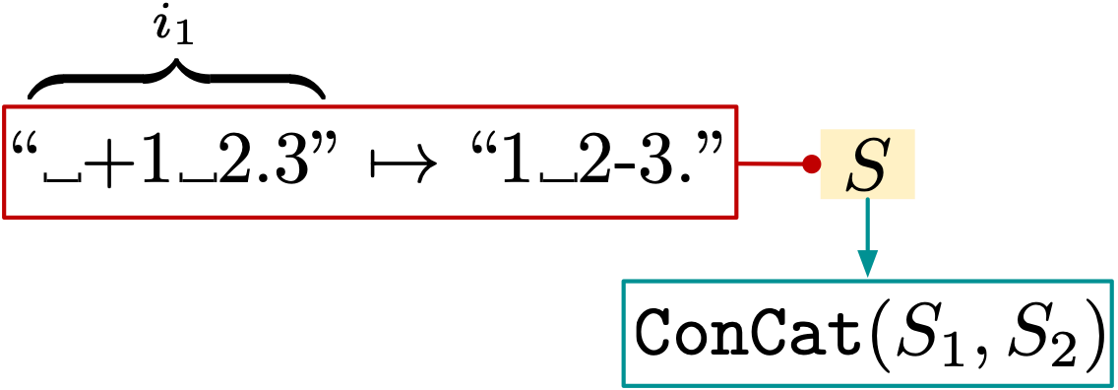
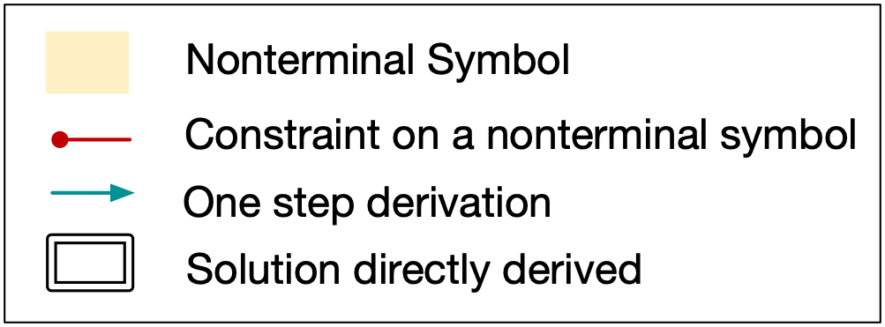
Top-Down Propagation
Notes:
For the given input-output example, suppose we are based on a hypothesis that the top-level operator of the solution is concatenation. A hypothesis is just a right-hand side of a production rule in the grammar.

Slide 20
Top-Down Propagation
Notes:
The inverse function of concatenation generates possible inputs that lead to the desired output.

Slide 21
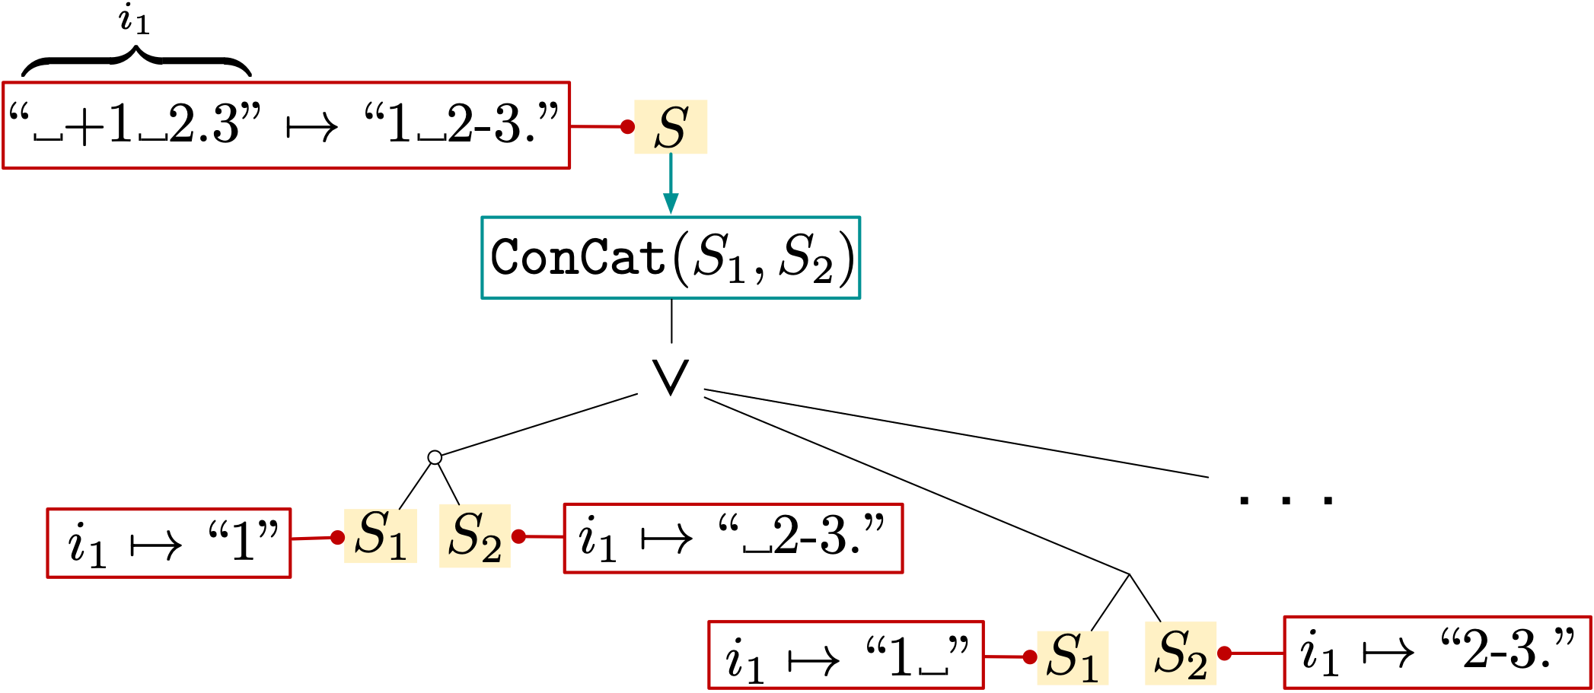
Top-Down Propagation
Notes:
Using the inverse-set generated by the inverse function, subproblems of synthesizing argument expressions of concat are deduced as follows.

Slide 22
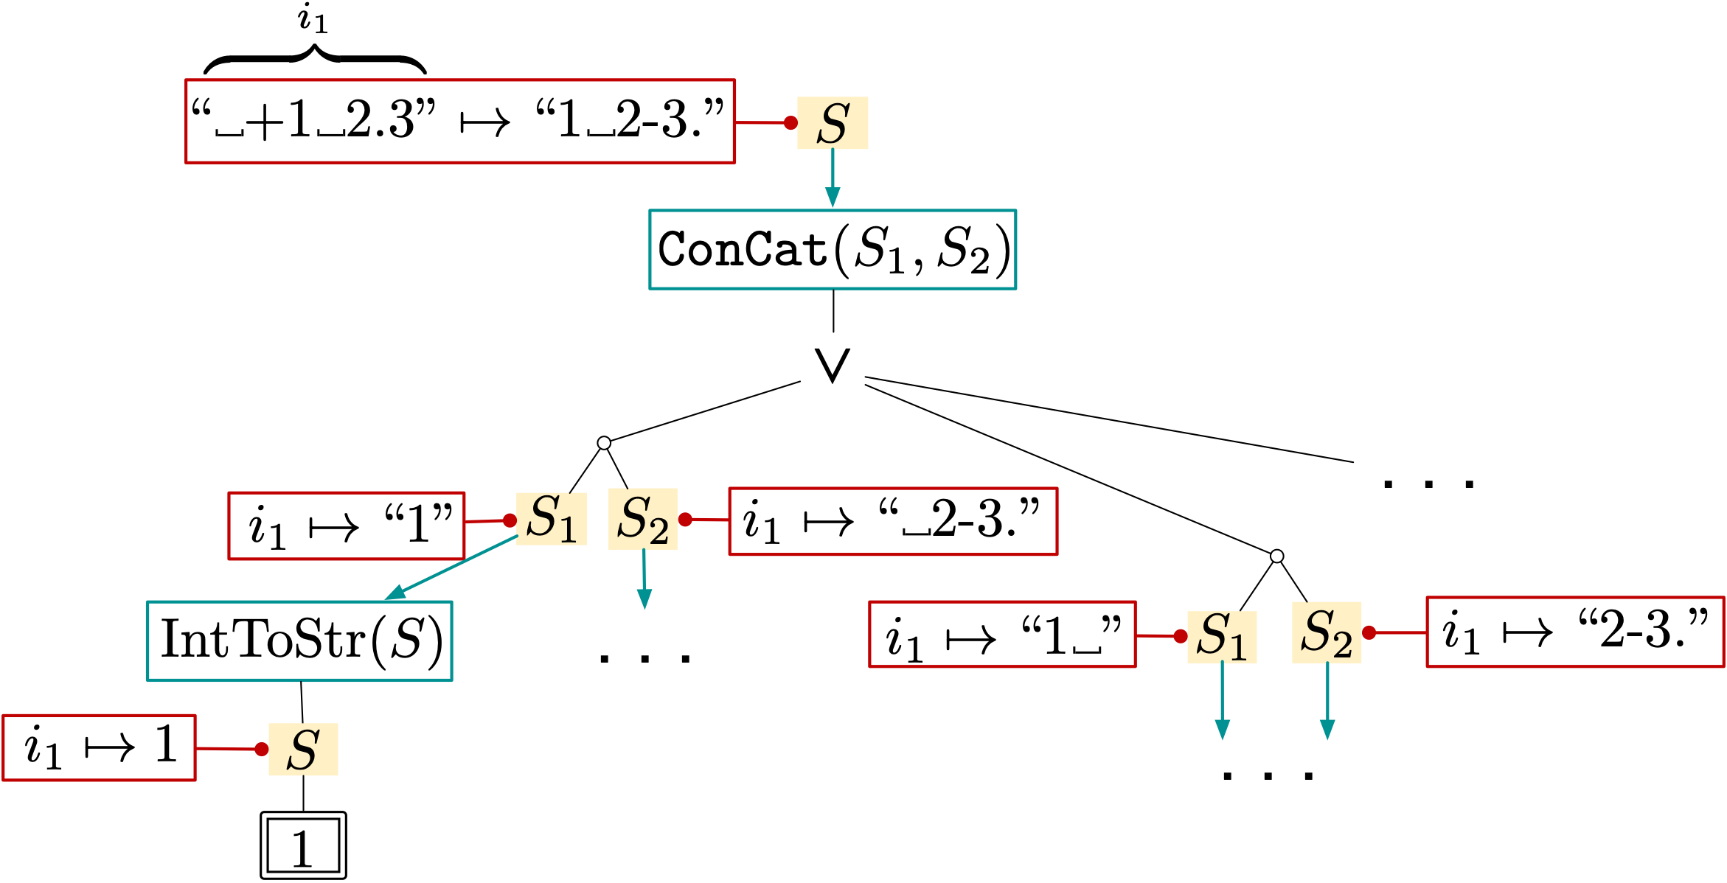
Top-Down Propagation
Notes:
Each newly deduced problem is recursively decomposed into multiple subproblems until no problems are left unsolved. For example, the problem of finding an expression that outputs string “1” for the given input is reduced to the problem of finding a program that outputs integer 1 assuming the top-level operator is the integer-to-string conversion operator. This subproblem is not further decomposed since it is trivially solvable. On the other hand, the other subproblems are further decomposed.

Slide 23
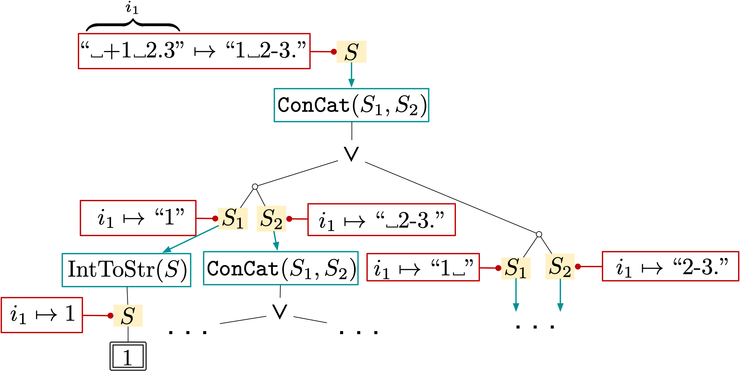
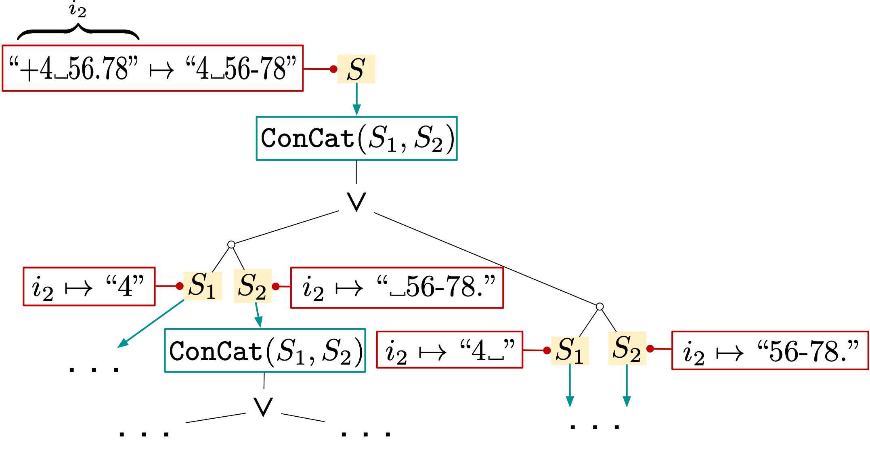
Top-Down Propagation
All possible solutions
for IO example 1
All possible solutions
for IO example 2
∩
stored in a space-efficient data structure
All possible final solutions
Notes:
For each of input-output example, top-down propagation of input-output examples is done,
and a set of all programs consistent with each input-output example is derived and stored in a space-efficient data structure. To construct a set of programs consistent with multiple examples, an intersection of sets of programs that are consistent with individual examples should be computed.

Slide 24
Top-Down Propagation
All possible solutions
for IO example 1
All possible solutions
for IO example 2
∩
+ very efficient (divide-and-conquer, goal-directed)
− # of IO examples↑ → performance ↓ − Not always applicable
stored in a space-efficient data structure
All possible final solutions
Notes:
This strategy is goal-directed in the sense that only subproblems related to the final goal are deduced, and very efficient through divide-and-conquer. However, this method does not scale well when a large number of input-output examples are provided because of the set intersection. Most importantly, this strategy is not always applicable.

Slide 25
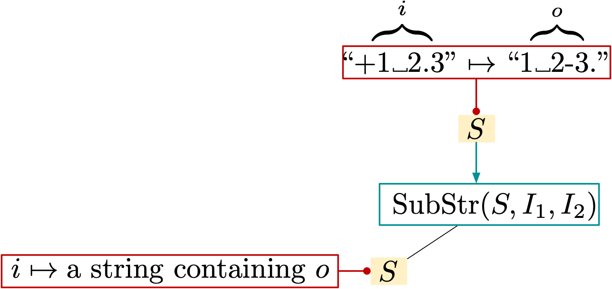
Top-Down Propagation
Problem: unconstrained arguments
Infinitely many such strings!
Inverse set is infinite.
Notes:
Top-down propagation is not applicable when there are infinitely many possible inputs that can result in a desired output. For example, suppose we want to deduce subproblems for arguments based on a hypothesis of substring. The desired output of the first argument would be any string containing the desired output string o in this case. The number of possible such strings is infinite, and we cannot deduce infinitely many subproblems. Let us call such arguments of infinite pre-images unconstrained arguments.

Slide 26
Top-Down Propagation
Problem: unconstrained arguments
Top-down propagation is not even applicable due to the general grammar.
Infinitely many such strings!
Inverse set is infinite.
Notes:
Because the grammar for the example SyGuS problem is too general, the previous Top-down propagation is not even applicable to the problem.

Slide 27
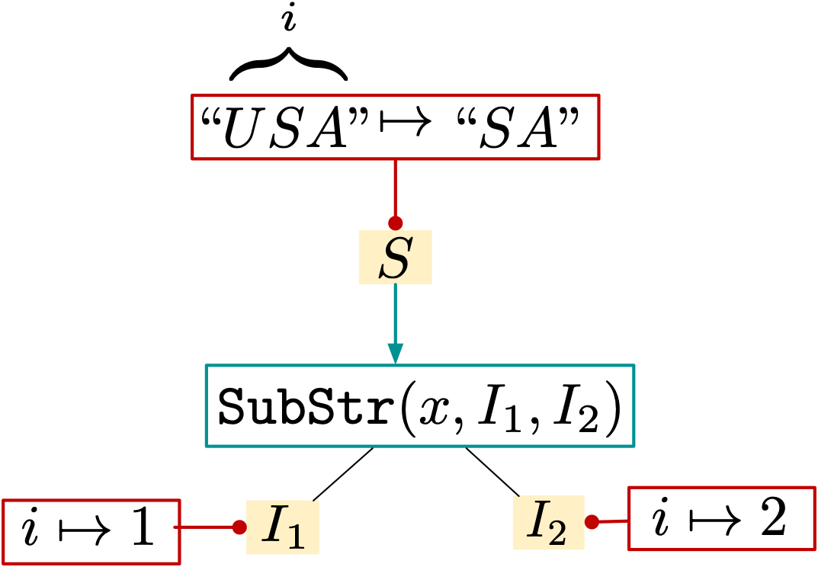
Top-Down Propagation
Previous incomplete workaround: restricting the grammar (which limits the kinds of programs that can be synthesized)
Input example
Notes:
The previous mitigation to this problem is restricting a grammar for an underlying DSL. If the grammar only allows the Substring operator to take input examples, preventing the other operators from being nested, then this syntactic restriction allows deducing two missing specified indices for a given specification by identifying the starting and ending positions of the desired output in the input example.

Slide 28
Only for DSLs with Balanced Expressivity
“DSL design = Art + Lots of iterations”
“The DSL should be expressive enough to represent various tasks… and restricted enough to allow efficient search.”
Gulwani et al., Program synthesis
Polozov et al., FlashMeta: a framework for inductive program synthesis
Gulwani et al., Programming by example (and its application to data wrangling)
Notes:
In general, this approach requires a great deal of domain expertise to achieve balanced expressivity of the underlying DSL. In other words, the DSL should be expressive enough for practical uses while being restricted enough to enable top-down propagation.

Slide 29
Our Key Idea
Bottom-up enumeration can quickly identify small but important subexpressions of the solution.
Our Top-down propagation: if an inverse set is infinite,
inverse set ⊆ {output of e | e is a component}, or
inverse set ⊆ {value similar to output of e | e is a component}
In places of unconstrained arguments
Notes:
Our key observation to overcome this limitation is as follows: while bottom-up enumeration is not scalable enough to find a large solution, it can at least quickly identifies small but important subexpressions of a solution. For example, a small subexpression ConCat(x, “.”) can be put in the place of the unconstrained argument, thereby limiting possible values for the other arguments. Based on this observation, we devise a variant of top-down propagation; whenever we encounter an unconstrained argument, we set its value space to be a subset of outputs of component expressions generated by Bottom-up enumeration. Or, sometimes we use values similar to outputs of components in order to generate subproblems that can be eventually solved by using components.

Slide 30
Component Generation
Suppose the initial component size is given 1. Bottom-up enumeration generates
Notes:
We describe our algorithm in detail. We first generate component expressions of certain sizes. Suppose the initial component size is given 1. Bottom-up enumeration generates the following set C of size 1 expressions.

Slide 31
Inverse Set ⊆ Outputs of Components
Component Pool
.
Search for a component that produces strings containing the outputs
Notes:
Next we perform Top-down propagation with the components. Based on the hypothesis of substring, we search for a component that produces strings containing the desired outputs o1 and o2. If we can find such a component, by fixing the first argument to be the component, we will be able to infer examples for the other arguments by identifying proper starting and ending positions of substrings.

Slide 32
Inverse Set ⊆ Outputs of Components
Component Pool
.
Simultaneous decomposition:
handle multiple IO examples simultaneously
no need for set intersection
our method scales well on the # of IO examples.
Notes:
Here, one difference between our method and the previous top-down propagation is that our inverse functions maintain a set of multiple input-output examples and perform simultaneous decomposition on the examples. In contrast, the previous top-down propagation perform decomposition for each individual example. This simultaneous decomposition obviates the need for set intersection, thereby scaling well on the number of input-output examples.

Slide 33
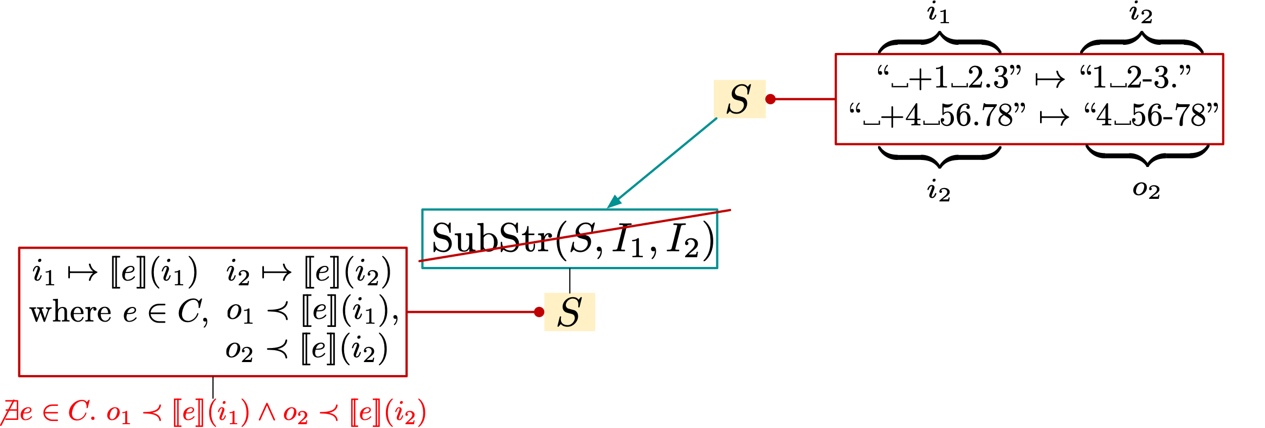
Inverse Set ⊆ Outputs of Components
Component Pool
.
No such a component. Reject the hypothesis.
Notes:
After searching for a component that produces strings containing the desired outputs o1 and o2, we conclude there is no such component in C. We reject the hypothesis and move on to other hypotheses.

Slide 34
We don’t miss a solution
We may miss the following solution of form at this iteration because we used size 1 components.
But we will find it by increasing the component size.
Search completeness: if a solution exists, we find it.
We should’ve used this component (size 6)
Notes:
At this point, you may be concerned about the possibility of missing solutions. Indeed, we may miss a solution whose top-level operator is substring at this iteration because the inverse set derived from the component pool C does not contain the outputs of all possible argument expressions. For example, the following expression is such a solution. To find this solution, we should’ve used components of size 9 but we just used size 1 components. However, the overall algorithm does not compromise the search completeness. Though we could not find this solution at this time, we will eventually find it by continuously increasing the component size.

Slide 35
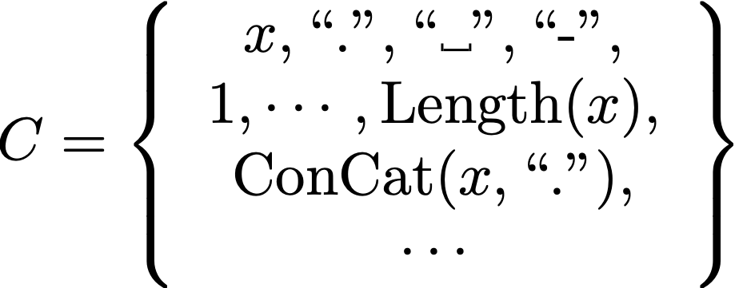
Component Generation
Now suppose the component size is increased to 3. Bottom-up enumeration generates
Notes:
Because we fail to construct a solution out of the components, we add more components. Suppose we’ve added components whose sizes are smaller than or equal to 3.

Slide 36
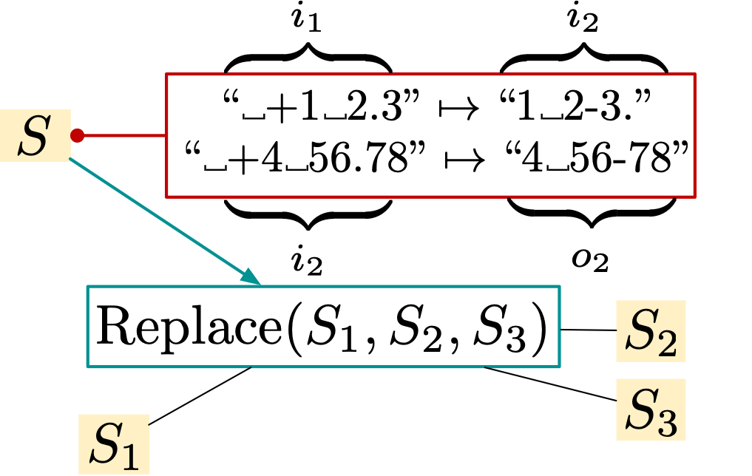
Inverse Set ⊆ Outputs of Components
Suppose now we consider the hypothesis
.
Simple similar to needs the following component
which is large (size 9) and cannot be efficiently generated.
Notes:
Based on the hypothesis of replacement, suppose we attempt to generate examples on the argument expressions. Similarly to the previous case, there are infinitely many possible values for S1, and we may confine the inverse set for S1 to be the set of outputs of components. However, to find the solution in this manner, we would need this subexpression of the solution, which is still too large to be generated by the component generator. To address this problem, we guide the decomposition to generate subproblems that can be eventually solved with the current set C of small expressions.

Slide 37
Component-guided Inverse Function
We generate subproblems that can be eventually solved by the current small components.
Our : find a component producing strings most similar to the desired outputs →
Compute alignments and generate specs for arguments
Notes:
We have devised an effective inverse function operator for string replacement. For the purpose of finding a small solution, we search for an expression in C which produces strings similar to o1 and o2 respectively so that a minimal number of string replacement operations may result in the desired output examples. The similarity is defined by string edit distance. For each component, we compute edit distance between its outputs and the desired outputs o1 and o2 and find out ConCat(x,”.”) produces strings closed to the output examples. We compute an alignment of the component outputs and desired outputs. An alignment is a pair of strings obtained by arranging two strings to identify regions of similarity as depicted in the figures. Epsilon denotes the empty word, and the highlighted in color denote mismatched characters.

Slide 38
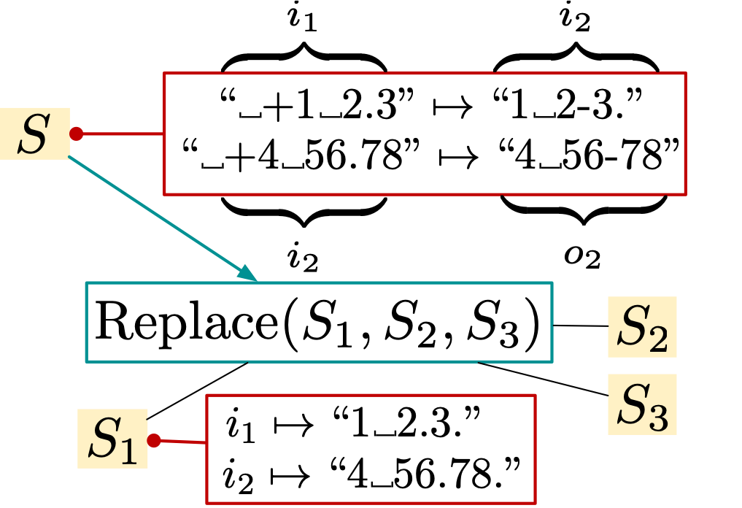
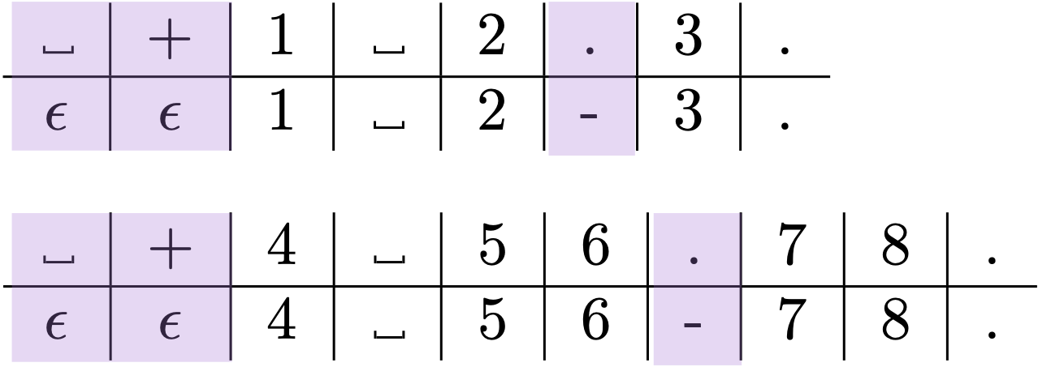
Component-guided Inverse Function
.
Desired outputs for S1
Notes:
From the alignments, we obtain desired outputs of the argument expressions. The highlighted in blue represent the desired outputs for the first argument expression,

Slide 39
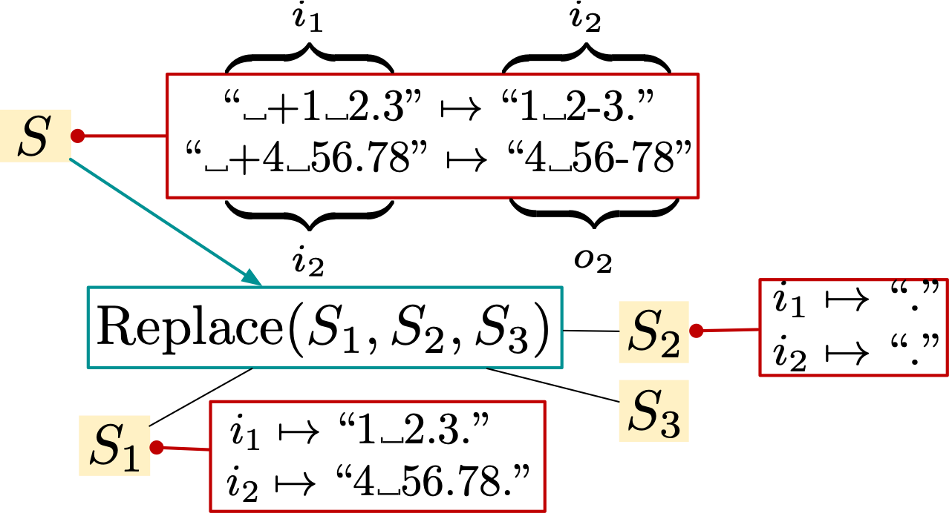
Component-guided Inverse Function
.
Desired output for S2
Notes:
The highlighted in red represent the desired outputs for the second argument expression,

Slide 40
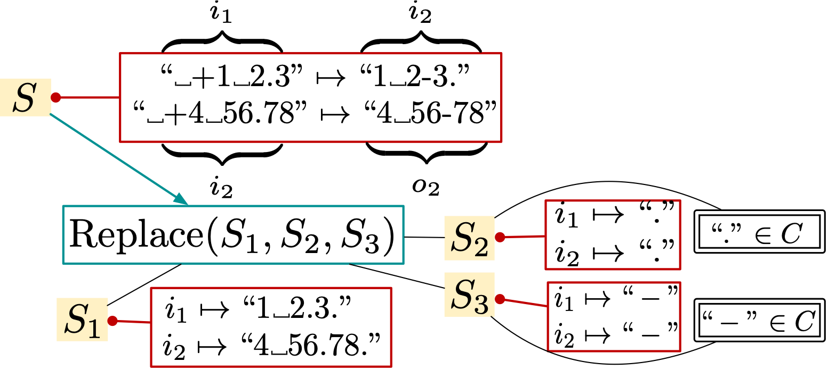
Component-guided Inverse Function
.
Continue Top-down propagation
Desired output for S3
Notes:
The highlighted in green represent the desired outputs for the last argument expression. The subproblems deduced for the second and last arguments are easily solvable with singleton components dot and hyphen. We continue decomposing the subproblem for the first argument.

Slide 41
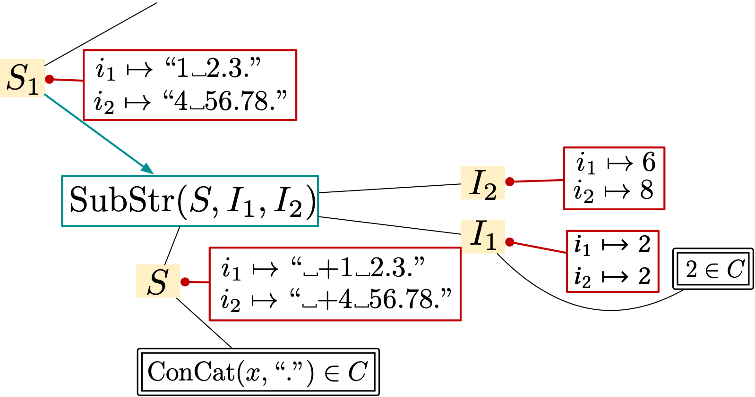
Component-guided Inverse Function
. . .
Notes:
Suppose we take the hypothesis of substring. We find the component concat(x, “.”) produces strings containing the desired outputs. The constraint on the second argument is to produce the starting position of the desired outputs, which is 2, and the constraint on the last argument is to produce the lengths of the desired output strings, which are 6 and 8. The constraint on the second argument is easily solvable.

Slide 42
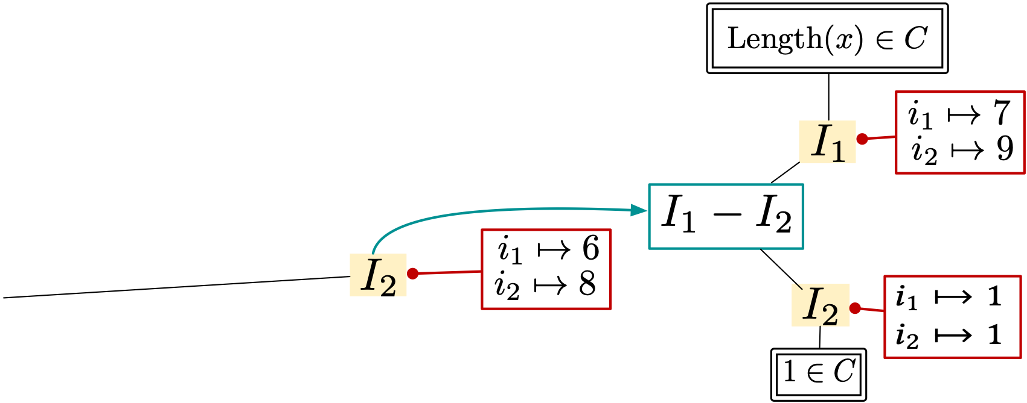
Component-guided Inverse Function
. . .
No subproblems unsolved. The solution is found.
Notes:
To solve the subproblem for the last argument, we use a hypothesis that the solution is of the form I1 - I2. Again, there are infinitely many combinations of such that I1 - I2 evaluates to 6 and 8 on the first and second input examples respectively. We search for a component that produces integers greater than 6 and 8, which is Length(x). By fixing I1 to be length(x), I2 is determined to be 1 accordingly. Because no subproblems are left unsolved, the solution is found.

Slide 43
Our Inverse Functions for SyGuS
Specialized for the operators supported in the SyGuS specification language (strings, bit vectors, LIA, and SAT)
Type 1: deducing specs not directly solvable with components (e.g., Replace⁻¹) → consecutive propagations
Type 2: deducing specs directly solvable with components (e.g., SubStr⁻¹) → solved in a single step
Notes:
We have devised inverse functions not only for the string domains but also for the other domains supported in the sygus specification language such as fixed-width bit vector, linear integer arithmetic, and SAT. The detailed definitions can be found in the paper. We recognize two types in the inverse functions we have defined. One type of inverse functions deduces input-output examples not directly satisfied by components. The inverse function for replace falls into this category. This type of inverse function incurs consecutive problem decomposition. The other type of inverse function deduces input-output examples that can be satisfied by components, thereby incurring a single deductive step.

Slide 44
Universal Inverse Function
In cases where (1) no particular domain knowledge of an underlying operator is exploitable, or (2) computing pre-images is expensive, we use the universal inverse function.
Suppose a spec is given on and
Then the universal inverse function computes the following pre-images:
enumerate all possible combinations of components
Notes:
Though we have defined inverse functions for various operators supported in the SyGuS language, there are cases where cost-effective inverse functions cannot be defined. If no particular domain knowledge of an underlying operator is exploitable, or computing inverse set is expensive, we use the universal inverse function. Suppose an input-output example specification is given on a nonterminal N which is associated with this production rule. Then the universal inverse function computes the following inverse set. It essentially enumerates all possible combinations of component expressions that can result in the given desired output.

Slide 45
Evaluation Setup
Benchmarks: 1,536 SyGuS problems
1,167 from the SyGuS annual competitions + 369 from optimization tasks for homomorphic evaluation [Lee et al. PLDI’20]
Comparison to three baselines (Timeout 1 hour):
EUSolver: winner of 2016 SyGuS competition
CVC4: winner of 2017 - 2019 SyGuS competition
Euphony [Lee et al. PLDI’18]: statistical model-guided synthesizer
Notes:
Now we present evaluation results. We have evaluated our tool Duet on 1500 synthesis tasks collected from the SyGuS competition benchmarks and our previous work of synthesis-based superoptimization. We compare our tool to EUSolver and CVC4, which are the winners of past sygus competitions, and Euphony, which is a statistical model-guided synthesizer.

Slide 46
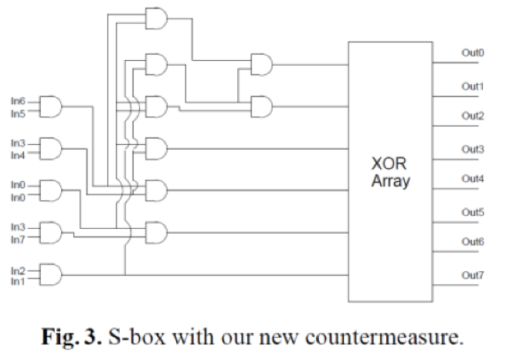
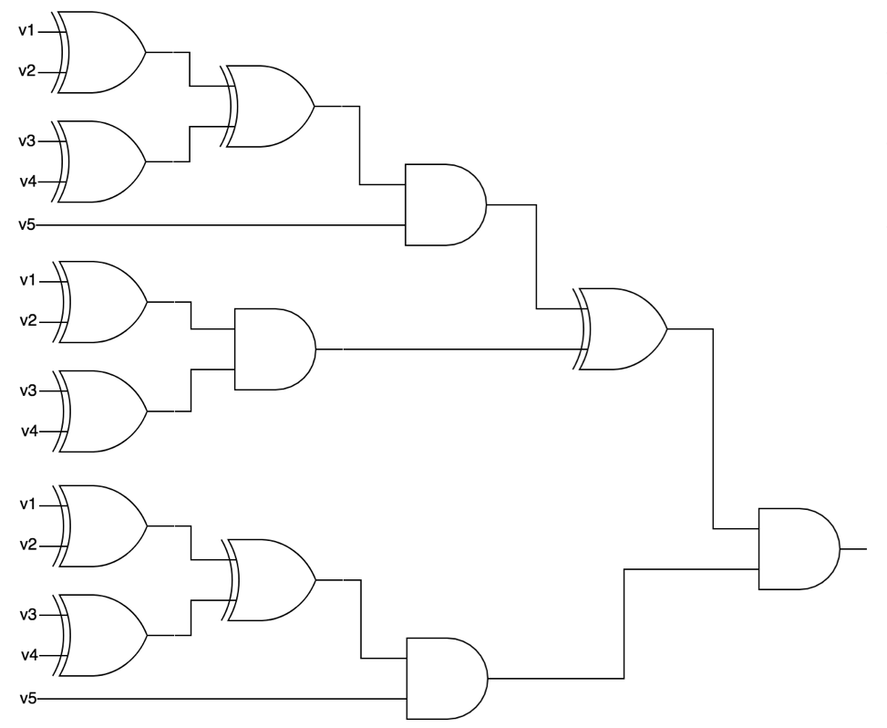
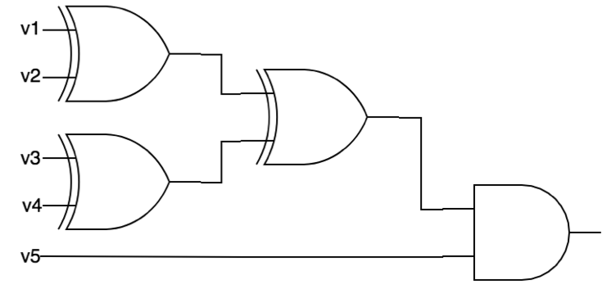
Benchmarks
STRING: End-user programming
205 problems
BITVEC: Efficient low-level algorithm
750 problems
CIRCUIT: Attack-resilient crypto circuits + Optimized homomorphic evaluation circuits
581 problems
Notes:
We chose synthesis tasks from three different application domains:
The String benchmarks correspond to common string manipulation tasks faced by spreadsheet users. The Bitvector benchmarks are for finding bit-manipulating programs from input-output examples. The Circuit benchmarks concern transforming given circuits into better ones in terms of performance or security.

Slide 47
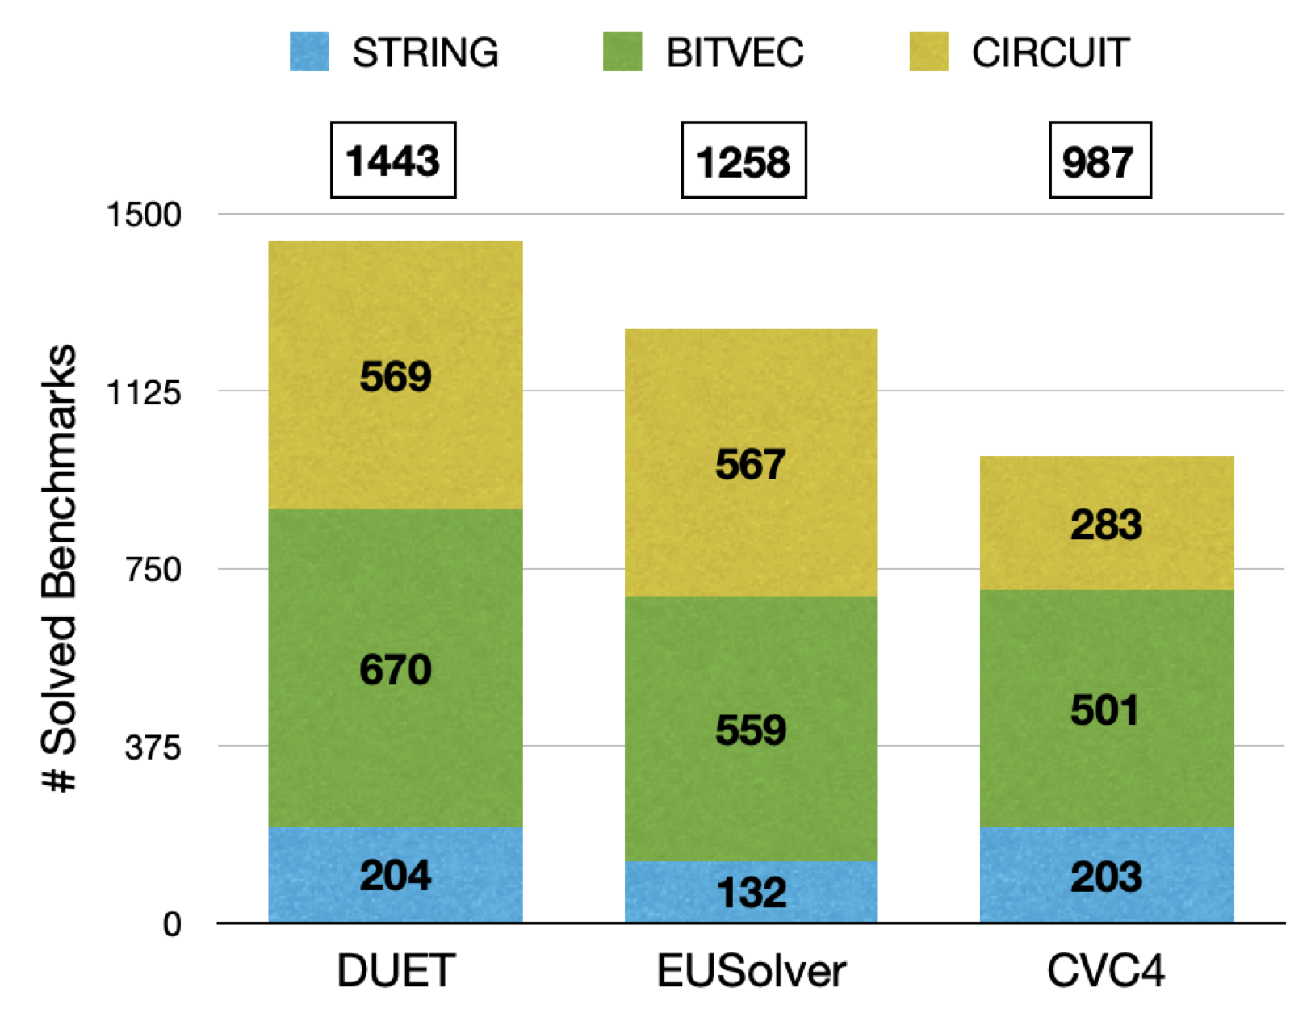
Comparison to the Winners of SyGuS Competitions
Duet solved more problems than the others …
Notes:
We first compare Duet to EUSolver and CVC4. Duet solved more problems than the others by solving about 94% of all the problems. EUSolver and CVC4 could solve only 82% and 64% respectively.

Slide 48
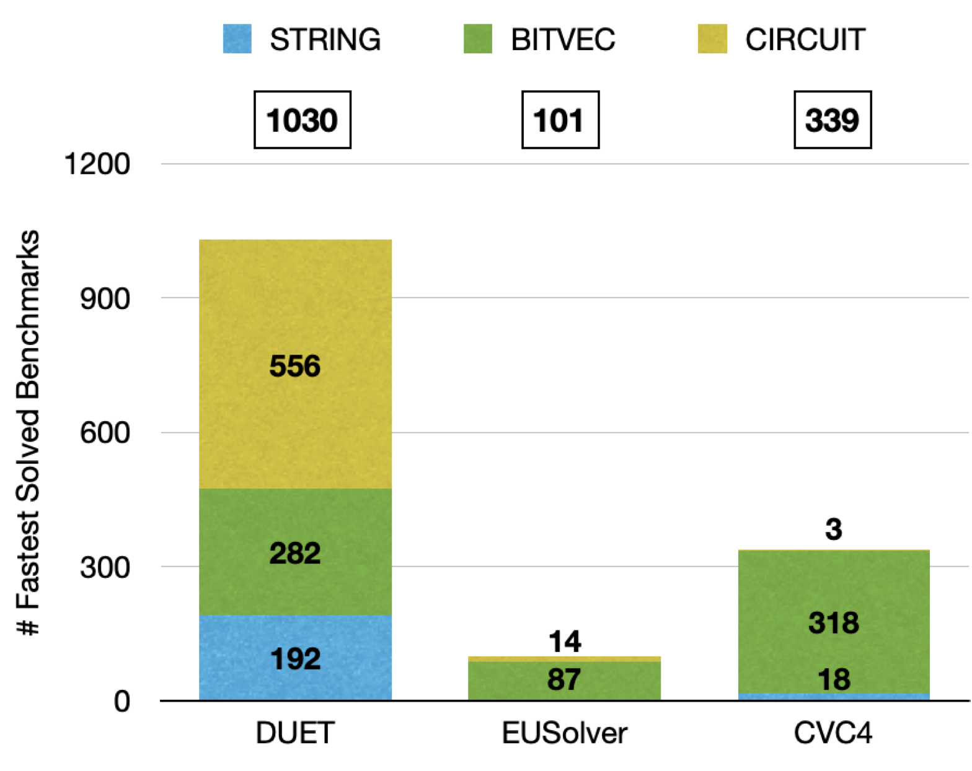
Comparison to the Winners of SyGuS Competitions
… in the fastest speed!
Notes:
Duet outperforms the others also in terms of synthesis time as well. Duet is the fastest solver in the vast majority of the problems.

Slide 49
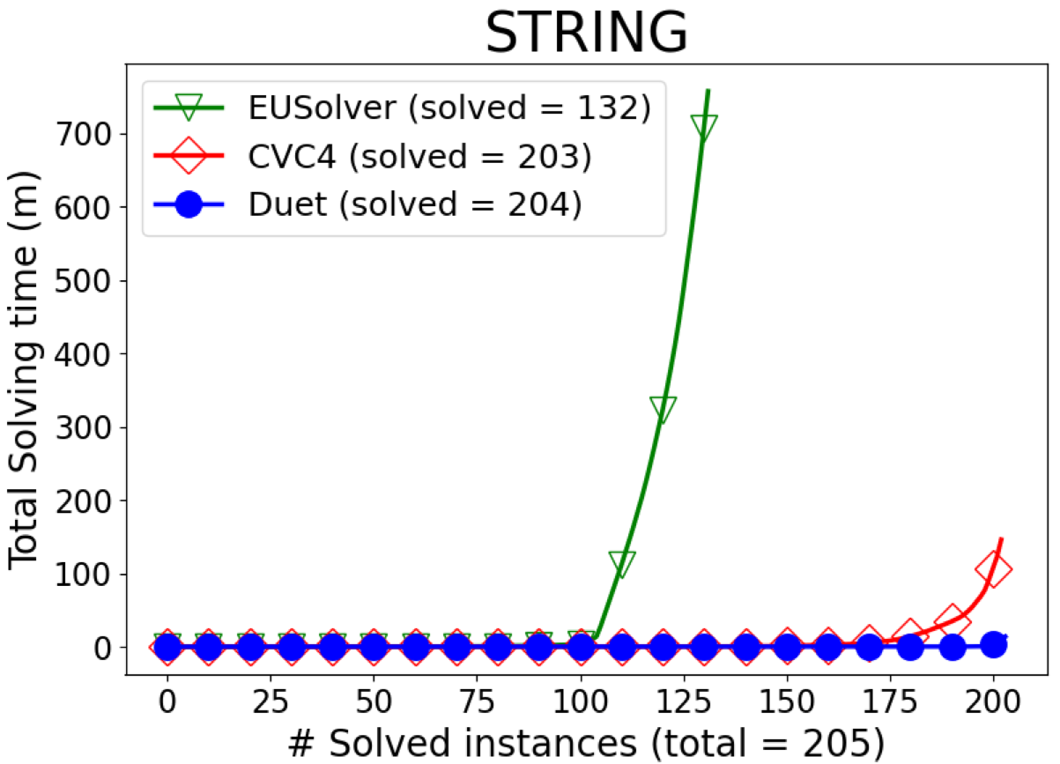
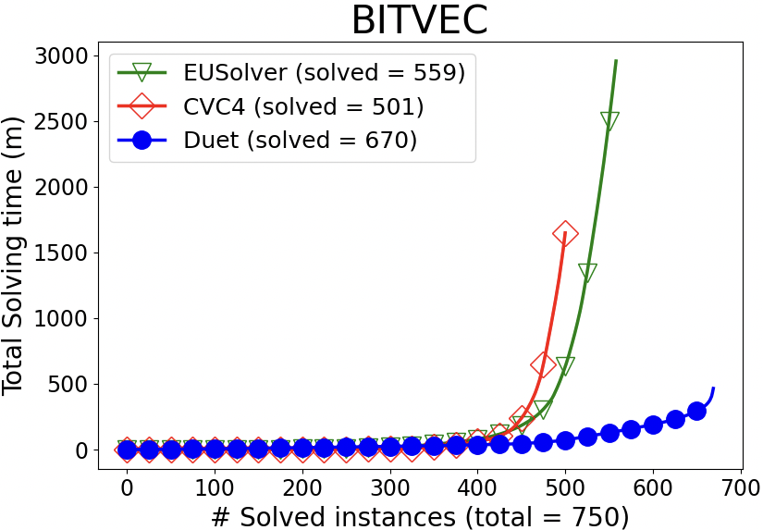
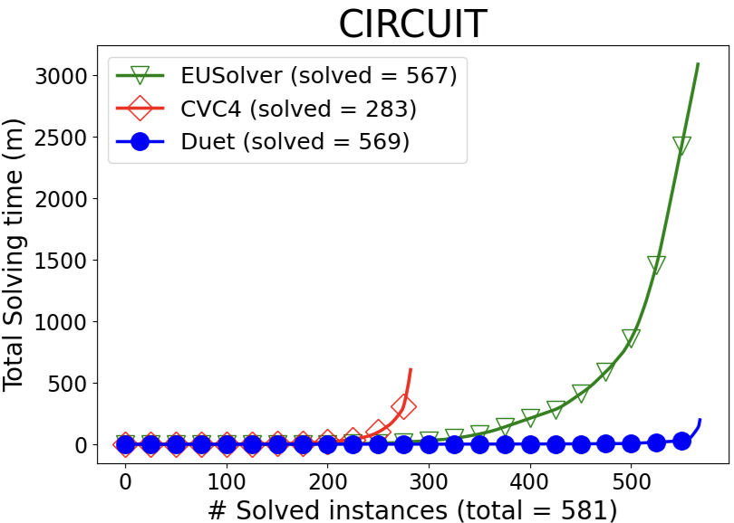
Comparison to the Winners of SyGuS Competitions
Duet solved all!
Duet solved
40% within 1 sec
77% within 10 secs
90% within 1 min.
Notes:
Here are more detailed results. Each plot shows the number of problems solved within a certain amount of cumulative time by the three solvers for each domain. Blue lines represent performance of Duet. The closer to X-axis, the better. Duet is the first tool that solves all the problems in the string domain, and it could solve 40% of problems within only 1 second each, and 90% of problems within 1 minute each.

Slide 50
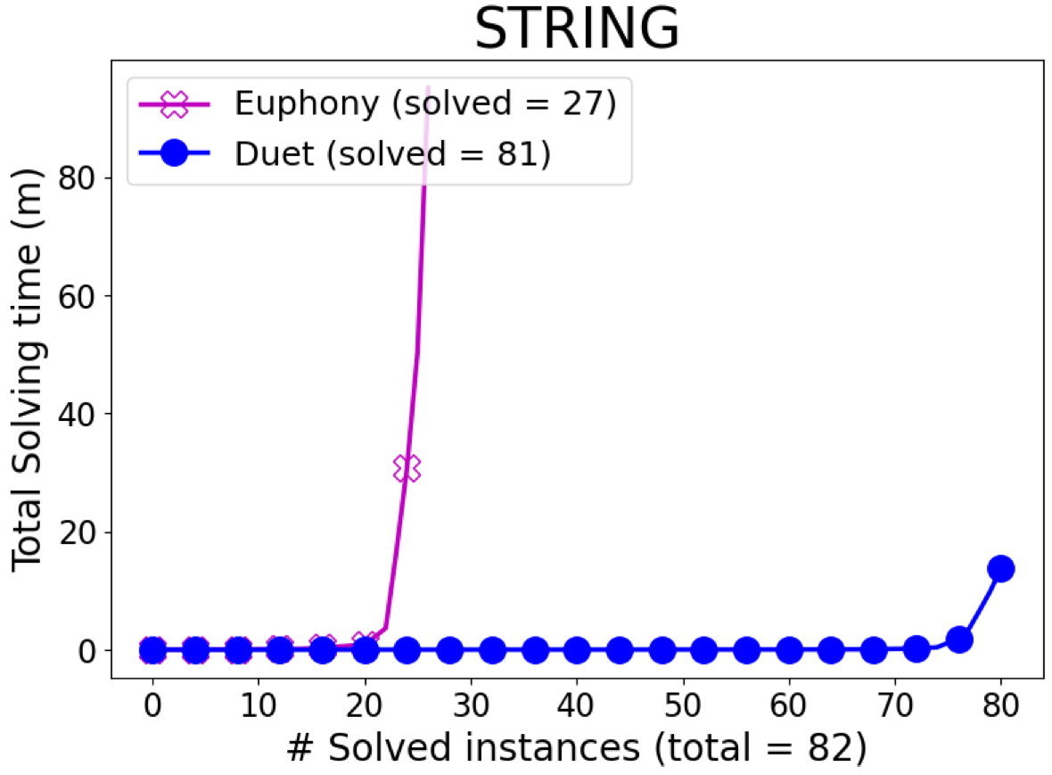
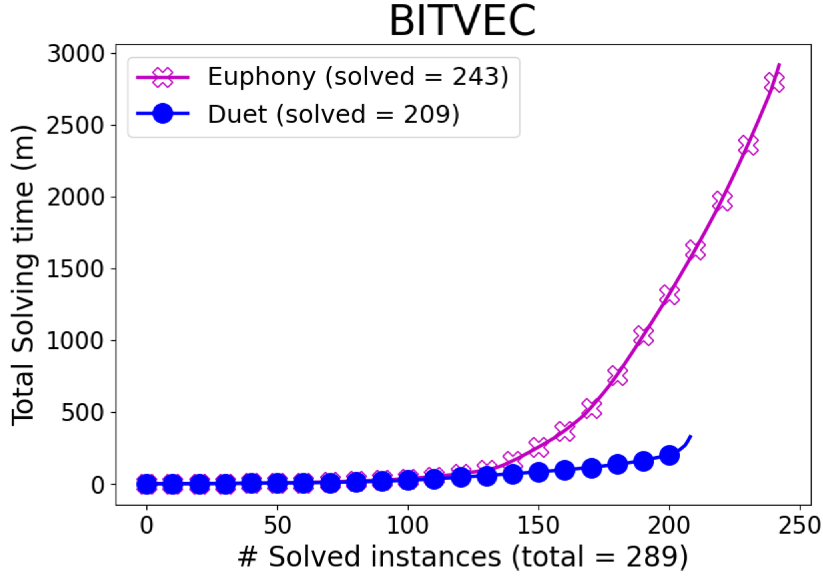
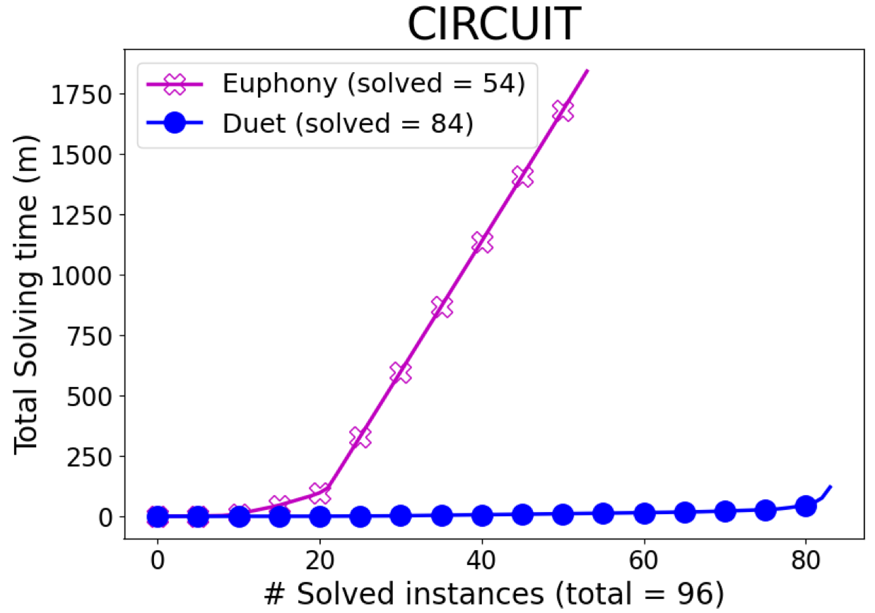
Comparison to Euphony
Training: 1,069 solved EUSolver in 10 min
Testing: 467
# solved: Duet: 374, Euphony 324
Notes:
Next, we compare Duet with Euphony which learns statistical models from easily obtainable solutions and use them to guide the search. For each domain, we use all problems that EUSolver could solve within 10 minutes each as the training set, and we train the model for that domain using the solutions found by EUSolver. The testing set comprises the other remaining 467 problems. In terms of the overall number of solved problems, DUET is better than euphony.

Slide 51
Comparison to Euphony
Training: 1,069 solved EUSolver in 10 min
Testing: 467
# solved: Duet: 374, Euphony 324
Duet solves harder synthesis problems more quickly compared to the state-of-the-art tools in diverse domains.

Slide 52
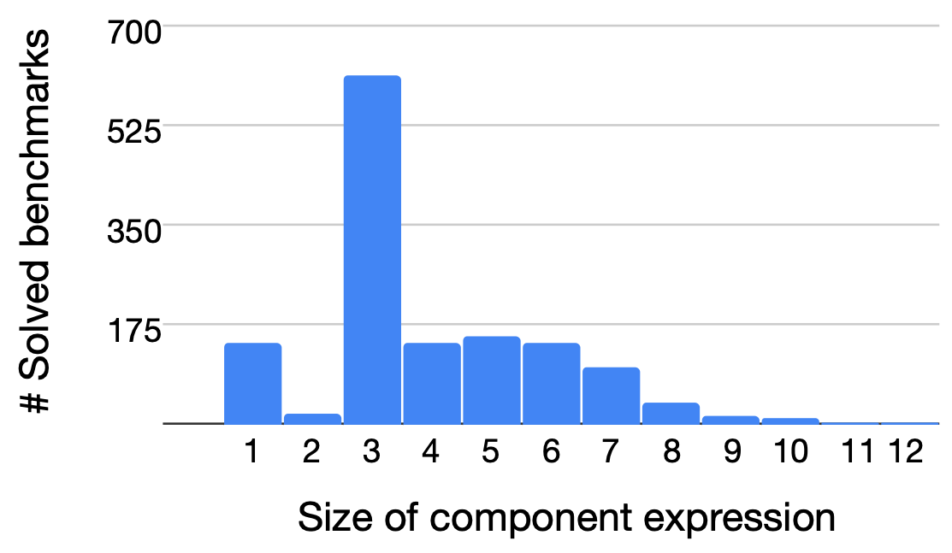
Analysis of Component Sizes
Sizes of components needed to construct a solution
STRING: 1 ~ 6 (avg: 1.8)
BITVEC: 3 ~ 5 (avg: 3.5)
CIRCUIT: 3 ~ 12 (avg: 5.9)
92% of problems could be solved with components of size ≤ 7.
Notes:
This figure shows the frequency distribution of benchmarks according to their maximum sizes of components when Duet finds a solution. Overall, the maximum size of components range from 1 to 12 with an average of 4. Out of solved 1443 problems in all the domains, 92% of problems could be solved with component expressions of size less than or equal to 7. Such small expressions can be quickly explored by the bottom-up enumeration in practice.

Slide 53
Analysis of Component Sizes
Sizes of components needed to construct a solution
STRING: 1 ~ 6 (avg: 1.8)
BITVEC: 3 ~ 5 (avg: 3.5)
CIRCUIT: 3 ~ 12 (avg: 5.9)
92% of problems could be solved with components of size ≤ 7.
Duet could construct solutions from small expressions.
Notes:
This indicates that Duet could compose solutions from small expressions.

Slide 54
In the paper…
Detailed description of our algorithm and inverse functions
Detailed discussions of algorithm properties: soundness / completeness / termination
Detailed description of the experimental results (e.g., analysis of overfitting, times spent for each step (component generation and composition)
Thank you!
Notes:
If you are interested in more details, please refer to our paper.
Thank you.

