Slide 1
Accelerating Search-Based Synthesis Using Learned Probabilistic Models
Woosuk Lee Kihong Heo Rajeev Alur Mayur Naik
University of Pennsylvania

Slide 2
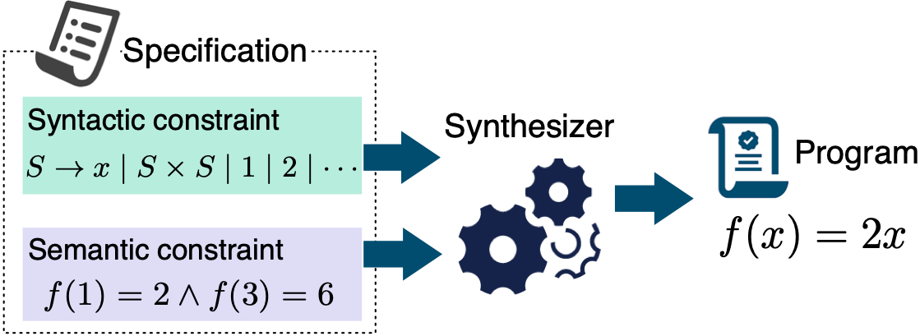
Syntax-Guided Program Synthesis (SyGuS)
Notes:
The goal of program synthesis is to automatically synthesize a target function that satisfies a given high-level specification. Such a specification can be given using a standard formulation called syntax-guided synthesis, shortly SYGUS. The formulation comprises a syntactic specification, in the form of a context-free grammar that constrains the space of possible programs, and a semantic specification, in the form of a logical formula which defines a correctness condition that the target function must satisfy.
This standardization established various synthesis benchmarks through annual competitions.

Slide 3
Existing General-Purpose Strategies
Enumerative: search with pruning
- EUSolver: Udupa et al. (PLDI’13)
Symbolic: constraint solving
- CVC4: Reynolds et al. (CAV’15)
Stochastic: probabilistic walk
- STOKE: Schkufza et al. (ASPLOS’13)
Notes:
The search techniques for SyGuS problems can be based on enumerative search, stochastic search, or constraint solving. Enumerative approach enumerates candidate programs in increasing order of size with a pruning technique. This approach is fast and robust in practice.
Stochastic approach keeps mutating an initial candidate sampled uniformly from a search space.
The approach has been proven to be useful for program super-optimization.
Symbolic approach casts a synthesis problem into a constraint solving problem.

Slide 4
Existing General-Purpose Strategies
Enumerative: search with pruning
- EUSolver: Udupa et al. (PLDI’13)
Symbolic: constraint solving
- CVC4: Reynolds et al. (CAV’15)
Stochastic: probabilistic walk
- STOKE: Schkufza et al. (ASPLOS’13)
Key limitation: search not guided towards likely programs
Notes:
Despite significant strides in these approaches, however, a key limitation is that they do not guide the search towards likely programs. They assume all possible programs are equally likely. As a result, they explore many undesirable candidates in practice, which will be shown with an illustrative example later in the talk. Our goal is to avoid many unlikely programs in the search.

Slide 5
Statistical Regularities in Programs
Programs contain repetitive and predictable patterns [Hindle et al. ICSE’12]
for (i = 0; i < 100; ??)
Statistical program models define a probability distribution over programs
Pr (?? → i++ | for (i = 0; i < 100; ??) ) = 0.80 Pr (?? → i-- | for (i = 0; i < 100; ??) ) = 0.01
- e.g., n-gram, neural network, probabilistic context-free grammar (PCFG), …
Many applications: code completion, deobfuscation, program repair, etc.
Notes:
I will explain what I mean by likely programs. It is well known that desired programs contain repetitive and predictable patterns. For example, consider an IDE into which a programmer has typed in this partial for loop statement. In this context, it would be quite reasonable for the IDE to suggest the completion i++ to the programmer. Another possible option i - - is unlikely because it will lead to an infinite loop. By exploiting such regularities, statistical program models define a probability distribution over programs. Thanks to the large and growing body of open-source programs, various statistical models have been proposed and proved successful in a variety of applications such as code completion, deobfuscation, program repair, among many others.

Slide 6
Exploiting Statistical Regularities
Can we leverage statistical program models to accelerate program synthesis?
Key Challenges:
How to guide the search given a statistical model?
How to learn a good statistical model?
Notes:
The success of statistical models for code has inspired us to incorporate the statistical method to synthesis. We’d like to answer this key question: Can we leverage statistical program models to accelerate program synthesis?
To solve this problem, we have modularly addressed two orthogonal but complementary challenges: 1) how to guide the search given a probabilistic model, and 2) how to learn a good probabilistic model.

Slide 7
Our Contributions
A general approach to accelerate CEGIS-based program synthesis
- by using a probabilistic model to guide the search towards likely programs - supports a wide range of models (e.g., n-gram, PCFG, PHOG, neural nets, …)
Transfer learning-based method to mitigate overfitting
Tool (Euphony) and evaluation on widely applicable domains
https://github.com/wslee/euphony
Notes:
We summarize the main contributions of our work as follows:
To address the first challenge, we propose a general approach to accelerate program synthesis based on the most popular synthesis paradigm called CEGIS. It uses a probabilistic model to guide the search towards likely programs. Also, we target the widely-used SyGuS formulation and supports a wide range of models.
To address the second challenge, we propose a transfer learning-based method to reduce overfitting. Lastly, we have implemented our method on top of a tool called Euphony and evaluated it on 1200 benchmark problems from widely applicable domains. The tool and artifact are available for download.

Slide 8
Talk Outline
Overall Architecture
Illustrative Example
Empirical Evaluation
Notes:
In the rest of the talk, I will first describe the overall architecture of Euphony, and I will illustrate our approach on an example synthesis problem. Lastly, I will show you the evaluation results.

Slide 9
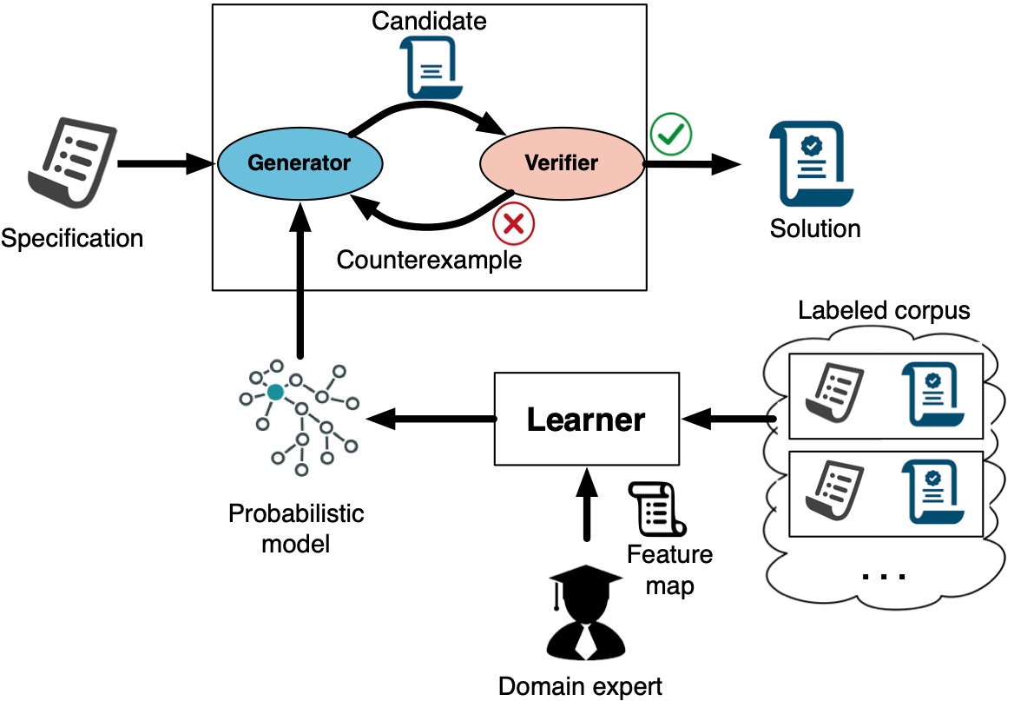
Overall Architecture
Notes:
Our system comprises two parts: the searcher and the learner. The searcher takes a synthesis specification and a statistical program model, and returns a solution. The learner trains a model from a labeled corpus of existing programs. Let me describe each of them.

Slide 10
CEGIS with Guided Search
- Enumerates candidates in order of likelihood
- Supports a wide range of probabilistic models
Notes:
The searcher internally uses the CEGIS procedure, which comprises two components. The generator keeps producing program candidates until it finds a program the verifier validates to be correct with respect to given specification.
The overall performance of this procedure depends heavily on the generator.
Our algorithm allows the generator to explore candidate programs in order of likelihood determined by a given statistical model.

Slide 11
Transfer Learning
- Problem: overfitting
- Our solution: generalize to unseen programs better using a feature map designed by domain expert
Notes:
To guide the search well, we certainly need a good model. However, blindly using existing statistical program models often leads to overfitting.
Our solution is to generalize to unseen programs better using a feature map designed by domain expert. In this talk, I will cover the guided search only. Please refer to the paper for our transfer learning method.
Statistical models for code are usually learnt from a code corpus. Training programs can be viewed as solutions of certain synthesis problems. Because semantic specifications are diverse in prace, solutions of target synthesis problems often follow different probability distribution from that of training corpus.
To address the issue, we propose a learning method inspired by transfer learning. We properly generalize texts of training programs by abstracting constant symbols. And then we can apply existing model learning method using the transformed programs. By doing it, knowledge gained solving some problems can be applied to different but related problems. For this transfer learning, we expect the user to provide domain knowledge in the form of a feature map for the transformations.

Slide 12
Talk Outline
Overall Architecture
Illustrative Example
Empirical Evaluation
Notes:
Now, I will describe how our guided search works with an illustrative example.

Slide 13
Example
Goal: a function that replaces a hyphen (-) by a dot (.) in a given string
Specification
Syntactic specification:
Semantic specification:
Solution
String concatenation
Rep(s, t1, t2): t1 in s is replaced by t2
Notes:
Let’s suppose we want to synthesize a function f that takes a string denoted x as input and outputs a string with each hyphen in x replaced by a dot.
The syntactic specification is provided as this context-free grammar. We consider programs that can perform string concatenation and replacement operations. S is the start nonterminal symbol.
The semantic specification follows the programming by example paradigm and comprises input-output examples given as this logical formula. A desired solution is Rep(x, “-”, “.”).

Slide 14
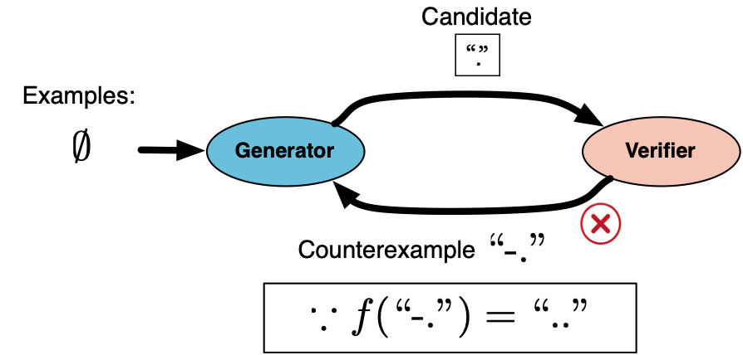
Enumerative Search: Unguided
Notes:
We next illustrate how a typical enumerative synthesizer finds this solution using the CEGIS procedure. The generator explored candidates in order of size. It first proposes the smallest program, let say, the expression “.”. The verifier checks the correctness of this program with respect to the specification, and yields a counterexample input “-.”. It is because the output of the expression on this counterexample does not match the desired output “..”.

Slide 15
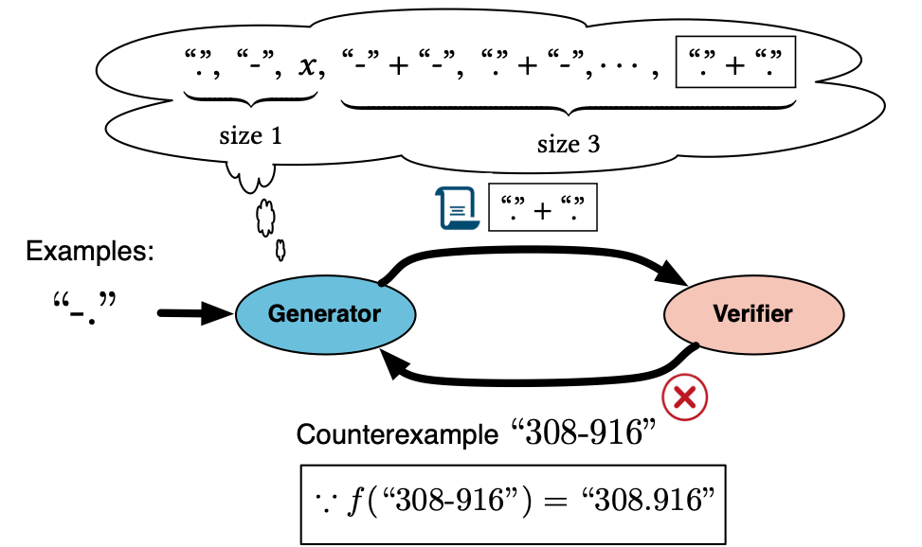
Enumerative Search: Unguided
Pruning optimization: “-” + “.” is not explored.
Notes:
In the next iteration, the generator searches for a program that generates the desired output for the counter example. The generator finds the expression “.” + “.” which is correct w.r.t. the counterexample.
During the search, the generator employs a powerful optimization. It avoids enumerating “-“ + “.” since it is equivalent to the expression x under the counter example input, and x is explored already. In this manner, it can prune the search space. Now, the verifier yields another counterexample.

Slide 16
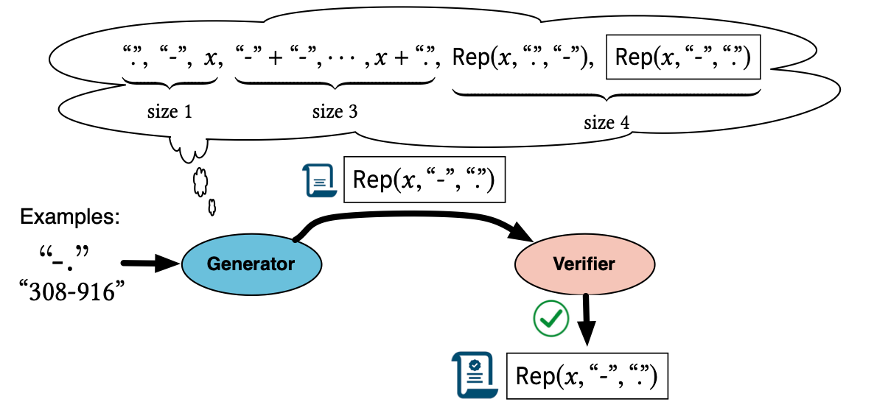
Enumerative Search: Unguided
Many unlikely programs (e.g., “.” + “.”) are explored.
Notes:
In the third iteration, the generator eventually finds the desired program Rep(x , “-”, “.”) that the verifier certifies to be correct.
In general, the number of programs enumerated by the above algorithm grows exponentially in program size, despite the powerful optimization. Since it assumes all possible programs are equally likely, there are many unlikely programs explored. For example, “.” + “.” explored in the second iteration above is unlikely since it doesn’t use the input at all.

Slide 17
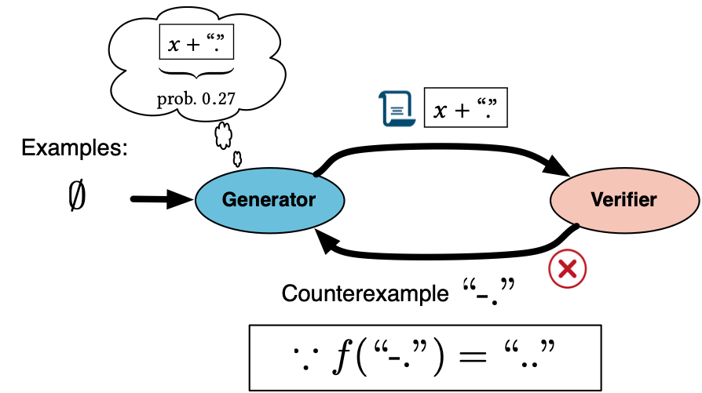
Enumerative Search: Guided
Enumerates in order of likelihood instead of size
Notes:
We propose a weighted enumerative algorithm to avoid unlikely programs.
Our algorithm is essentially the same as the existing enumerative algorithm except that it enumerates programs in order of likelihood instead of size. The generator first proposes x + “.”, which is found only in the third iteration by the existing enumerative search.
The verifier yields this counterexample for a similar reason.

Slide 18
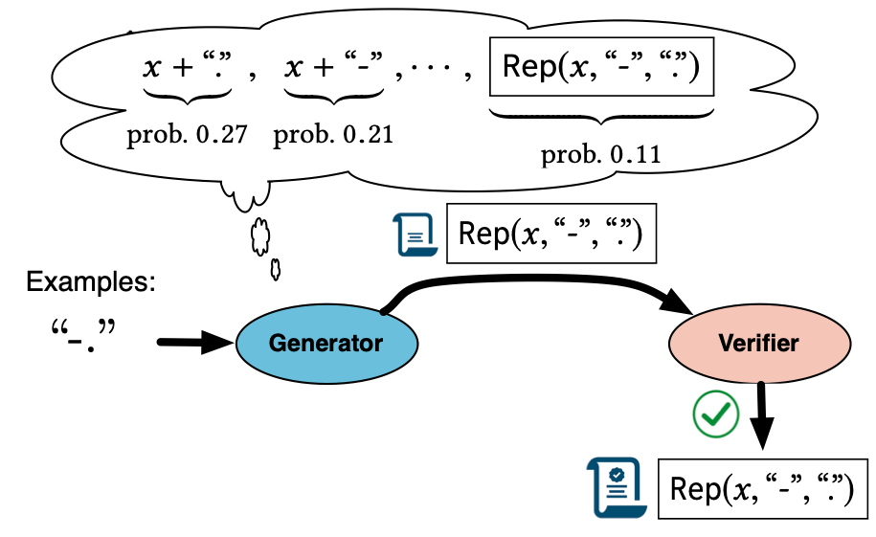
Enumerative Search: Guided
Avoids many unlikely candidates
Preserves the pruning optimization
Notes:
In the next iteration, it quickly finds the solution because it avoids enumerating many unlikely programs. Also, we preserve the pruning optimization technique used in the existing approach.

Slide 19
A Uniform Interface to Statistical Program Models
Given a sequence of terminal/nonterminal symbols (i.e., sentential form), provide a probability for each production rule
Determines a probability of a given program (e.g., )
Notes:
Next, we elaborate our uniform interface to statistical program models. Any models that fit into this interface can be used for our guided search.
We assume a model provides a probability for each production rule given a sequence of terminal/nonterminal symbols so called a sentential form.
Then, the probability of a program under a statistical program model can be obtained by multiplying probabilities of applied production rules conditioned on a current sentential form at each step.
A statistical program model of a context-free grammar is a probability distribution over programs in a language generated by the grammar.
The model predicts probabilities of next applicable production rules for a given sequence of ternimanl and nonterminal symbols, which is often called a sentential form.
This allows to compute a probability of a program. Suppose this is a unique derivation of a program x + “.”. Then, the probability of the program under a statistical program model by can be obtained by multiplying probabilities of applied production rules to a current sentential form at each step.

Slide 20
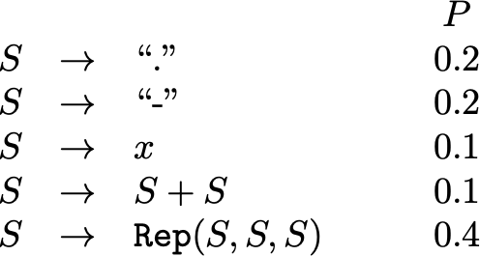
Examples of Models
Probabilistic context-free grammar (PCFG)
Notes:
Let me give you some examples of such models.
The simplest example is PCFG where each rule is associated with a probability.
This model is so simple in that probabilities of rules being fired are not conditioned on anything.

Slide 21
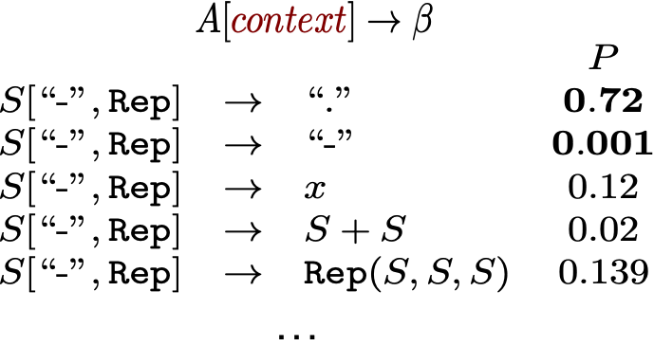
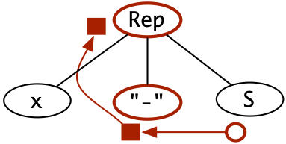
Examples of Models
Probabilistic Higher-order Grammar (PHOG) (the model we use)
PHOG when is symbols at
left sibling and parent
Others: n-gram, a neural network-based model, log-bilinear model …
Notes:
A more advanced model called PHOG is more context-aware, and we use it for our solver.
The left figure depicts a PHOG for the original CFG. It allows the non-terminal symbol on the left side of each production rule to be parameterized by a context that captures contextual information around a production position. The context is a list of terminal/non-terminal symbols that can be collected from the abstract syntax tree (AST) of a sentential form.
A PHOG can be learned from syntax of existing programs. In this example, we assume that a learner infers that the symbols at the left sibling and the parent of a production position provide meaningful information.
Let’s assume we want to compute a probability of the nontermal S being expanded to a dot in this sentential form.
The obtained context is [“-”, Rep], and the probability of the production rule S →“.” is 0.72.
There are also other models such as …

Slide 22
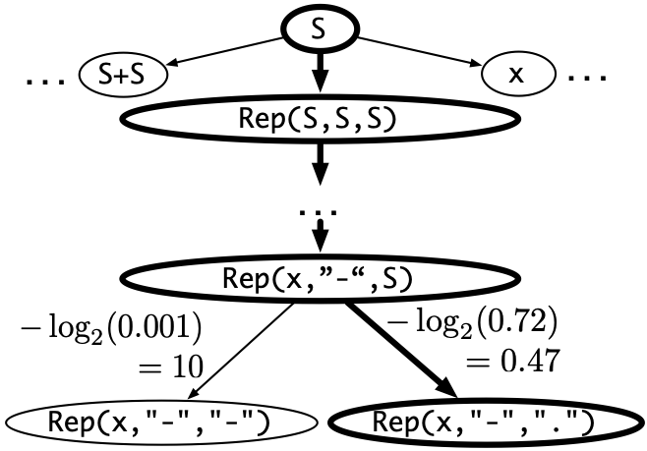
Guided Enumeration via Path Finding
Given a model, we construct a directed graph.
Nodes: sentential forms
s1 → s2: s1 expands to s2 by applying a production rule r
w(s1 → s2) = - log ( Pr (r | s1) )
r
r
Notes:
Assuming such a model is given, we first construct a directed weighted graph. Each node represents a sentential form that can be derived from the start non-terminal S. Each edge s1 → s2 means that s1 expands to s2 by applying a production rule to the leftmost non-terminal symbol in s1. Each edge is associated with a weight which is the negative log probability of its corresponding production rule.

Slide 23
Guided Enumeration via Path Finding
Idea: solving a shortest pathfinding problem via A* search
Start node: S
Goal nodes: all programs
A heuristic function designed to work with any model
Notes:
In this setting, the sum of the weights on a path from S to a node representing a program is the negative log probability of the program. Now, we solve the single-source shortest path problem. We have a start node S and multiple goal nodes representing all programs in the search space. Then, enumerating programs in order of decreasing probability corresponds to enumerating goal nodes in increasing order of the shortest distance from S. For example, the solution node is explored earlier than the other program in the left since it is closer to the start node. We use A* search algorithm for pathfinding. One noteworthy thing is we automatically compute a precise heuristic function that affects the overall performance of A*. Please refer to the paper for more details.

Slide 24
Problem of Overfitting
Suppose we are given a similar synthesis problem with the following semantic specification:
Desired solution: (the inverse of the previous solution

Slide 25
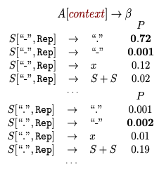
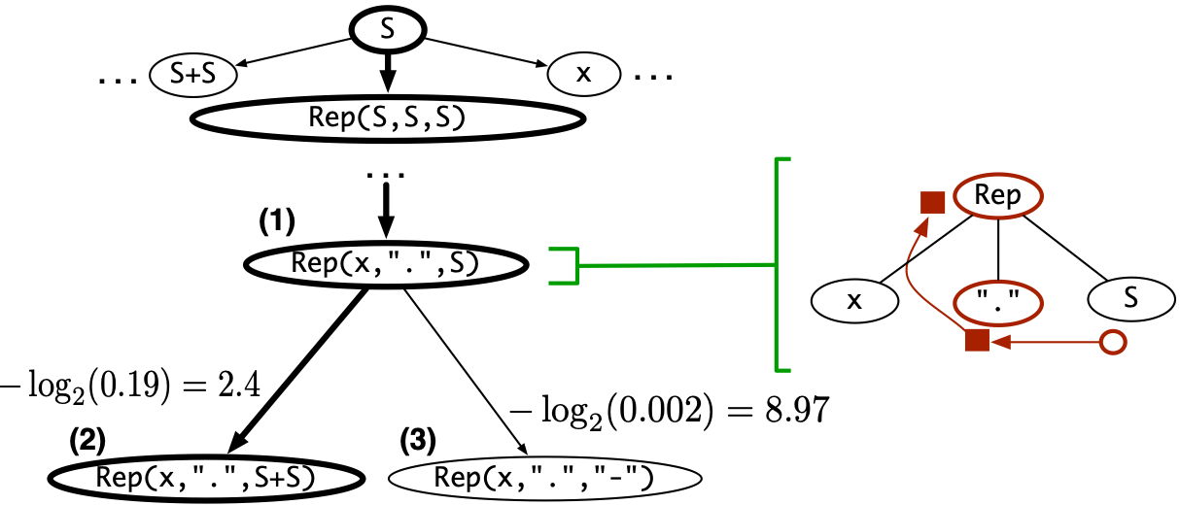
Problem of Overfitting
Suppose we want to complete (node (1))
Search is not guided toward the solution (node (2) is chosen instead of (3) ).
PHOG sticks to syntactic information, which may lead to overfitting.

Slide 26
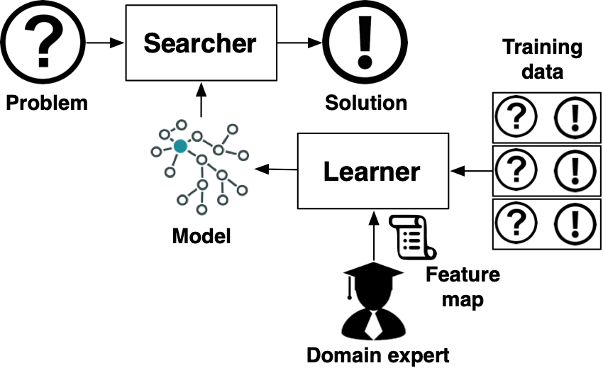
Transfer Learning
Training data: solutions of existing synthesis problems
Testing data: solutions of unseen synthesis problems
They may follow different probability distributions because of diverse semantic specifications.
Transfer learning reduces discrepancy between the probability distributions of training and testing data
Notes:
Transfer learning is machine learning with an additional source of information apart from the standard training data: knowledge from one or more related tasks.

Slide 27
Transfer Learning using Common Features
Spec:
Solution:
Spec:
Solution:
A constant string appearing in the inputs
A constant string appearing in the outputs
A constant string appearing in the inputs
A constant string appearing in the outputs

Slide 28
Transfer Learning using Common Features
Spec:
Spec:
A constant string appearing in the inputs
A constant string appearing in the outputs
Notes:
We transform the original constant symbols into featured terminal symbols representing certain types of constant strings.

Slide 29
Types of Constant Strings
constIO represents the set of substrings of all the strings in I ∩ O
constI represents the set of substrings of all the strings in I
constO represents the set of substrings of all the strings in O
const⊥ represents all the remaining strings.

Slide 30
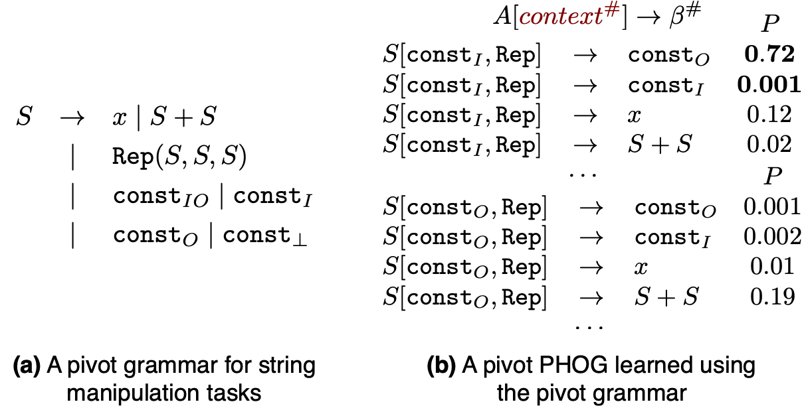
Pivot PHOG

Slide 31
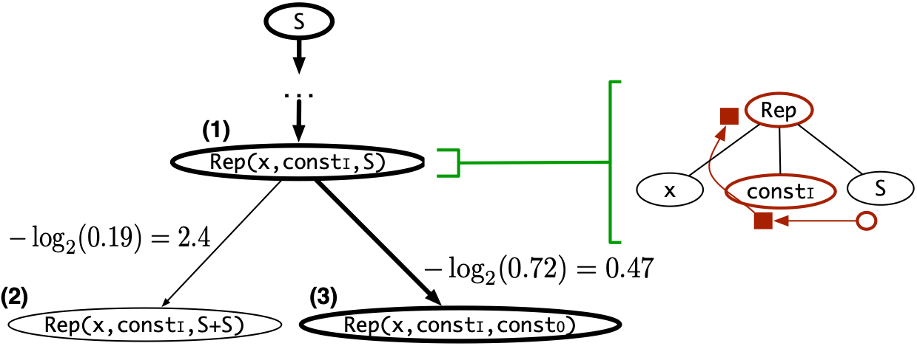
Search with the Pivot PHOG
Before
After

Slide 32
Talk Outline
Overall Architecture
Illustrative Example
Empirical Evaluation

Slide 33
Evaluation Setup
Benchmarks:
- 1,167 problems from SyGuS competition and online forums
Comparison to two baselines:
- EUSolver (general-purpose): winner of SyGuS competition
- FlashFill (domain-specific): string processing in spreadsheets
Notes:
We have evaluated our tool Euphony on 1200 synthesis tasks collected from the SyGuS competition benchmarks and online forums. We compare our tool to EUSolver, which is the winner of the last year sygus competition, and FlashFill, known to be the best solver for string processing in spreadsheets which is shipped in Microsoft Excel.

Slide 34
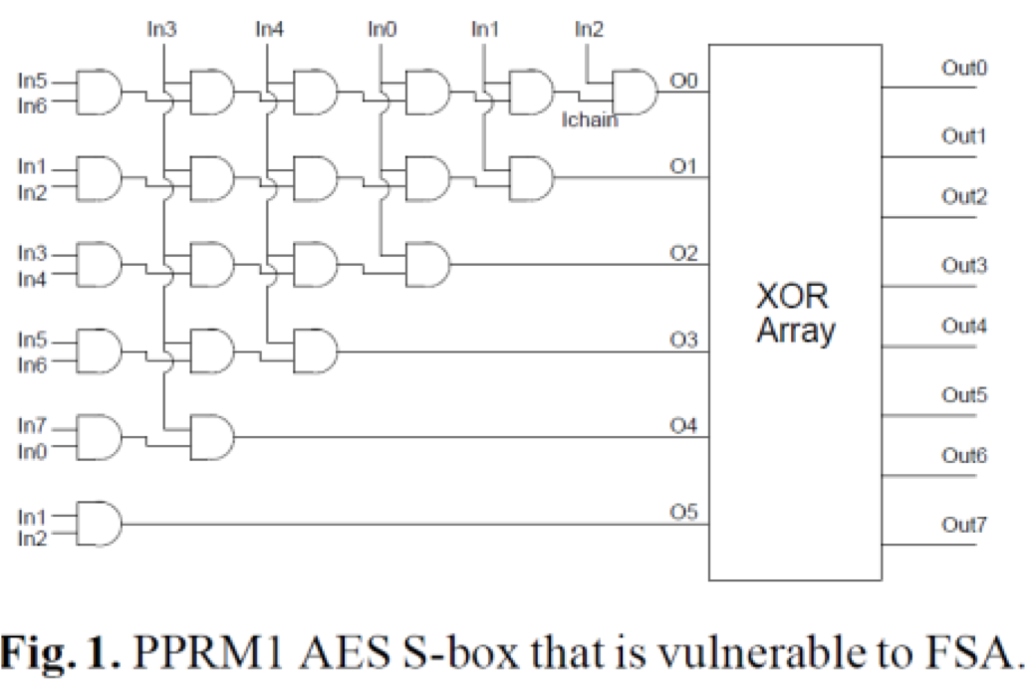
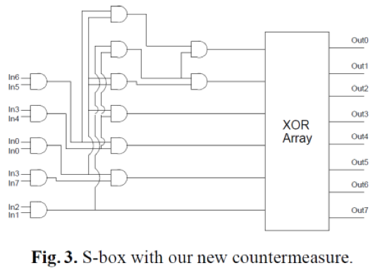
Benchmarks
STRING: End-user Programming
205 problems
BITVEC: Efficient low-level algorithm
750 problems
CIRCUIT: Attack-resistant crypto circuits 212 problems
Notes:
We chose synthesis tasks from three different application domains:
The String benchmarks correspond to common string manipulation tasks faced by spreadsheet users. The Bitvector benchmarks comprise 750 problems to find bit-manipulating programs from input-output examples. The benchmarks are motivated by program deobfuscation.
The Circuit benchmarks comprise 212 problems. Each problem is, given a cryptographic circuit, to synthesize another circuit that is functionally equivalent to the original circuit and resilient to side-channel attacks.

Slide 35
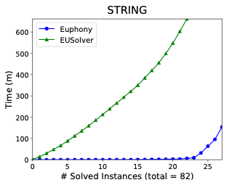
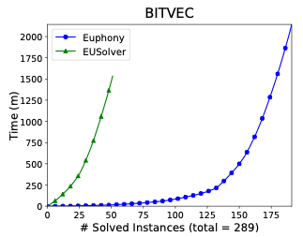
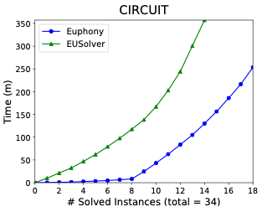
Comparison with EUSolver
Training: 762 solved by EUSolver in 10 min
Testing: 405 (timeout: 1 hour)
# solved: Euphony 236, EUSolver 87
Notes:
We first compare Euphony with EUSolver. We learn a statistical model by training on easily obtainable solutions that EUSolver can obtain within 10 minutes and generalize it to solve harder problems. Euphony could solve 236 problems within the timeout limit, whereas EUSolver only solved 87. The following figures show the cumulative running times of both solvers. Each figure shows the number of benchmarks solved within a given time limit. For instance, in the bit vector domain, EUSolver can solve only 50 benchmarks within 1500 seconds, whereas Euphony can solve 180 benchmarks.

Slide 36
Result for STRING benchmarks
T/O
T/O
T/O
T/O
T/O
T/O
205 problems (training 123 / testing 82)
T/O
T/O
Euphony solved 78% within 1 min
solved 8 on which EUSolver timed out
outperformed EUSolver on all
Notes:
We next study the result for the string domain in detail.
Out of 82 problems, Euphony could solve 27 problems, The chart in the right shows the synthesis times of both solvers. Euphony found 78% of these solutions within a minute and solved 8 problems on which EUSolver timed out.

Slide 37
Comparison with FlashFill (STRING)
113 problems handled by FlashFill
Training: 91 solved by FlashFill in 10 s
Testing: 22 (timeout: 10 min)
Euphony outperforms in 20 / 22
T/O
 | Average | Median
Euphony | 13 s | 3 s
Flashfill | 140 s | 78 s
T/O
Notes:
Next, we compare Euphony with FlashFill. Among 113 problems that can be handled by the FlashFill domain specific language, we train a model from solutions found by FlashFill within 30s, and apply it to the remaining instances.
In terms of the number of solved problems, FlashFill is better than Euphony (Euphony timed out on 2 problems whereas FlashFill solved all). However, Euphony significantly outperforms FlashFill in terms of synthesis time. Except for one problem, Euphony is able to find solutions within 1 minute.

Slide 38
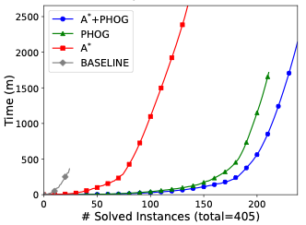
Efficacy of A* Search
Using PCFG and PHOG [Bielik et al. ICML’16]
# Solved (timout: 1 hour):
A* + PHOG: 236
Dijkstra + PHOG: 209
A* + PCFG: 133
Dijkstra + PCFG: 22
Notes:
We now evaluate the effectiveness of our A* search.
The following figure shows the cumulative running time of Euphony under different settings.
We compare the performance of four variants of Euphony, each using a different combination of probabilistic model (PCFG or a state-of-the-art model called PHOG) and search algorithm (A* or Dijkstra). Dijkstra is a special case of A* where the heuristic function always returns 0. Irrespective of which model we use, A* search always significantly outperforms Dijkstra.

Slide 39
In the paper …
General heuristic function for A* search
How to preserve orthogonal search optimizations
Feature maps for the three application domains
Effectiveness of different models

